Slide 1
Analysis on SG Waste Management
Tan Wen Tao Bryan (p2214449)
DAAA/FT/1B/01

Slide 2
Datasets Sources
Waste Type 2003-2017 (Dataset 1)
Abid, A., (2022). Singapore waste management 2003-2017 [online]. Kaggle. Available from: https://www.kaggle.com/datasets/kingabzpro/singapore-waste-management?select=2003_2017_waste.csv [Accessed at 28 Jan 2023]
Waste Type 2018-2020 (Dataset 2)
Abid, A., (2022). Singapore waste management 2018-2020 [online]. Kaggle. Available from: https://www.kaggle.com/datasets/kingabzpro/singapore-waste-management?select=2018_2020_waste.csv [Accessed at 28 Jan 2023]
Waste Disposed Of And Recycled, Annual (Dataset 3)
Data.gov.sg, (2015). Waste Disposed Of And Recycled, Annual [online]. Available from: https://data.gov.sg/dataset/waste-disposed-of-and-recycled-annual?view_id=8c49f9f3-2578-4039-8e78-06d0832dcc75&resource_id=7918b229-0e79-4d74-b725-e34183a56c01 [Accessed at 28 Jan 2023]
Volume of Domestic & Non-Domestic Waste Disposed in Singapore from 2012 to 2021 (Dataset 4)
Statista, (2022). Volume of waste disposed in Singapore from 2012 to 2021 [online]. Available from: https://www.statista.com/statistics/628000/waste-disposed-in-singapore/ [Accessed at 28 Jan 2023]
Waste Type 2021 (rows of data concat to Dataset 2)
NEA, (2022). Waste Statistics and Overall Recycling 2021 [online]. Available from: https://www.nea.gov.sg/our-services/waste-management/waste-statistics-and-overall-recycling [Accessed at 28 Jan 2023]

Slide 3
Datasets Sources (API)
Air Pollutants - Nitrogen Dioxide (Dataset 5)
Data.gov.sg, (2022). Air Pollutant - Nitrogen Dioxide [online]. Available from: https://data.gov.sg/dataset/air-pollutant-nitrogen-dioxide?view_id=9ae8988e-e4ad-4468-a04a-11ecd841f207&resource_id=f8060108-f102-41e2-be12-fe264a34bba4 [Accessed at 28 Jan 2023]
Air Pollutants - Particulate Matter 2.5 (Dataset 6)
Data.gov.sg, (2022). Air Pollutant - Particulate Matter PM2.5 [online]. Available from: https://data.gov.sg/dataset/air-pollutant-particulate-matter-pm2-5?view_id=5e24aca5-8a19-43e7-9c48-574686586397&resource_id=2e47ab6d-e327-4eb0-824f-e3ab6a5984db [Accessed at 28 Jan 2023]
Air Pollutants - Ozone (Dataset 7)
Data.gov.sg, (2022). Air Pollutant – Ozone (Maximum 8-hour Mean) [online]. Available from: https://data.gov.sg/dataset/air-pollutant-ozone?view_id=4e43fa8c-38d9-4f3c-a647-0a024d3446e9&resource_id=1bdc3a3e-27bd-4b5b-b13a-2e36528fb785 [Accessed at 28 Jan 2023]

Slide 4
Nature of Original Datasets
Waste Statistics from 2003-2017 for each Waste Type (Waste Disposed, Recycled, Generated, Recycling Rate)
Waste Statistics from 2018-2020 for Waste Type (Waste Recycled per `000 tonnes, Waste Generated per `000 tonnes)
df1
waste_type object
waste_disposed_of_tonne int64
total_waste_recycled_tonne int64
total_waste_generated_tonne int64
recycling_rate float64
year int64
dtype: object
df2
Waste Type object
Total Generated ('000 tonnes) int64
Total Recycled ('000 tonnes) int64
Year int64
dtype: object
Overall Waste Statistics from 2000-2014 (Waste Disposed per million tonnes, Waste Recycled per million tonnes)
Domestic Waste per million tonnes, Non-Domestic Waste per million tonnes from 2012-2021
df3
year int64
waste_disposed_of float64
waste_recycled float64
dtype: object
df4
year object
Domestic Waste Disposed object
Non-Domestic Waste Disposed object
dtype: object

Slide 5
Nature of Original Datasets
Mean of Nitrogen Dioxide from year 2000-2021
Mean of Particulate Matter 2.5 from year 2002-2021
df5 - NO2
nitrogen_dioxide_mean object
year int32
__id int32
dtype: object
df5 - PM2.5
pm2.5_mean object
year int32
__id int32
dtype: object
Max 8-hour Mean of Ozone from year 2000-2021
df5 - O3
ozone_maximum_8hour_mean object
year int32
__id int32
dtype: object

Slide 6
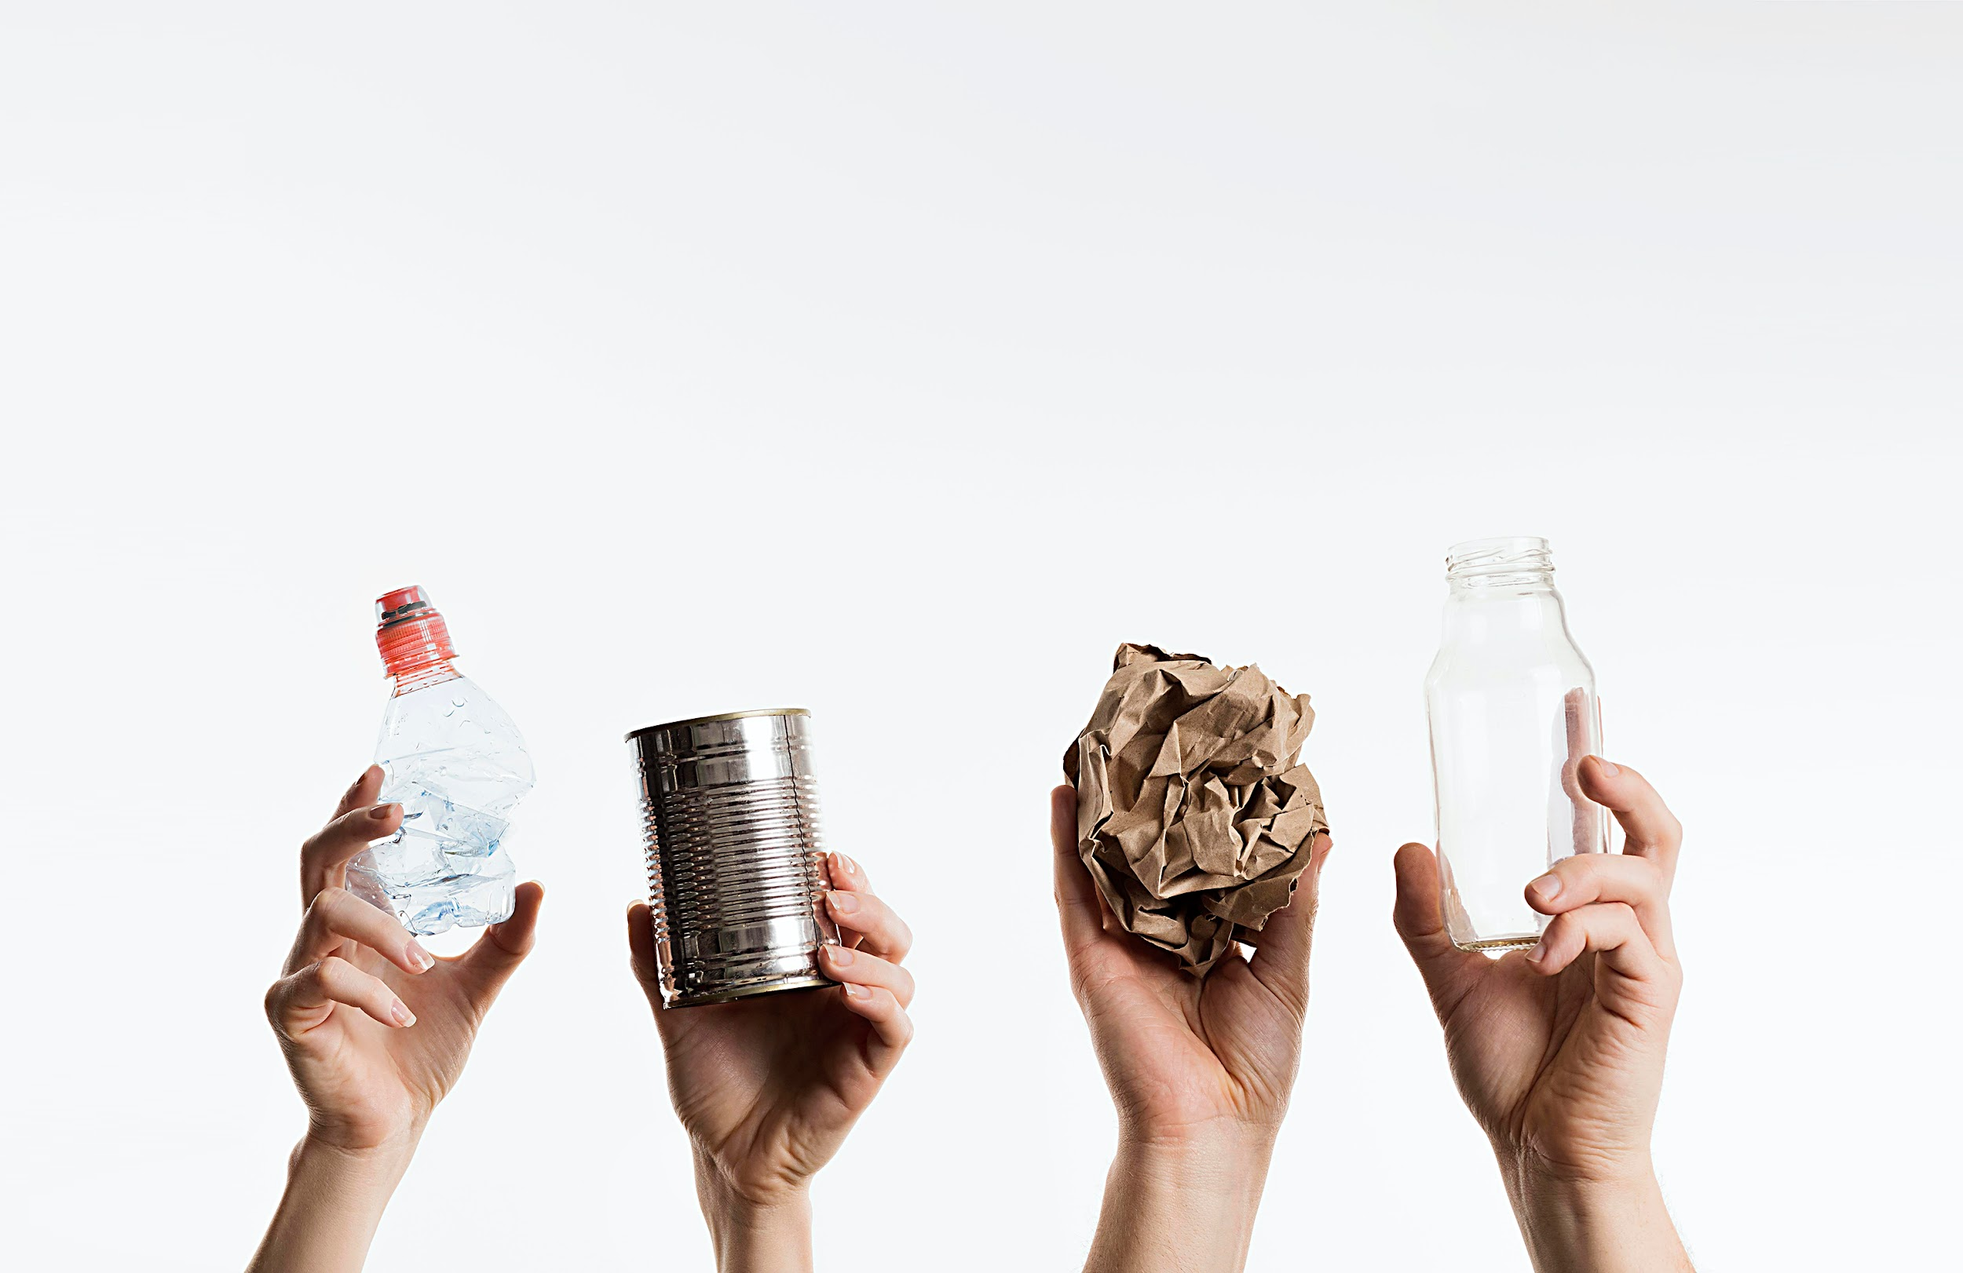
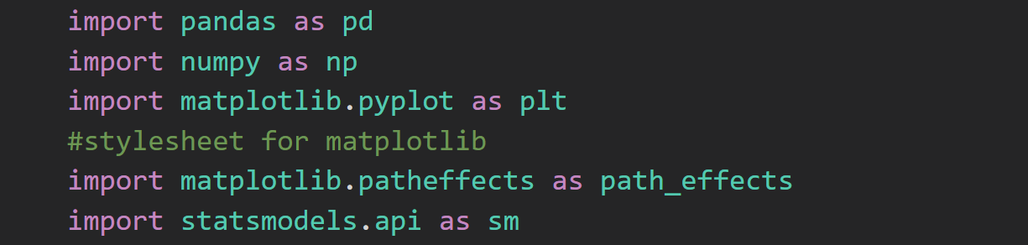
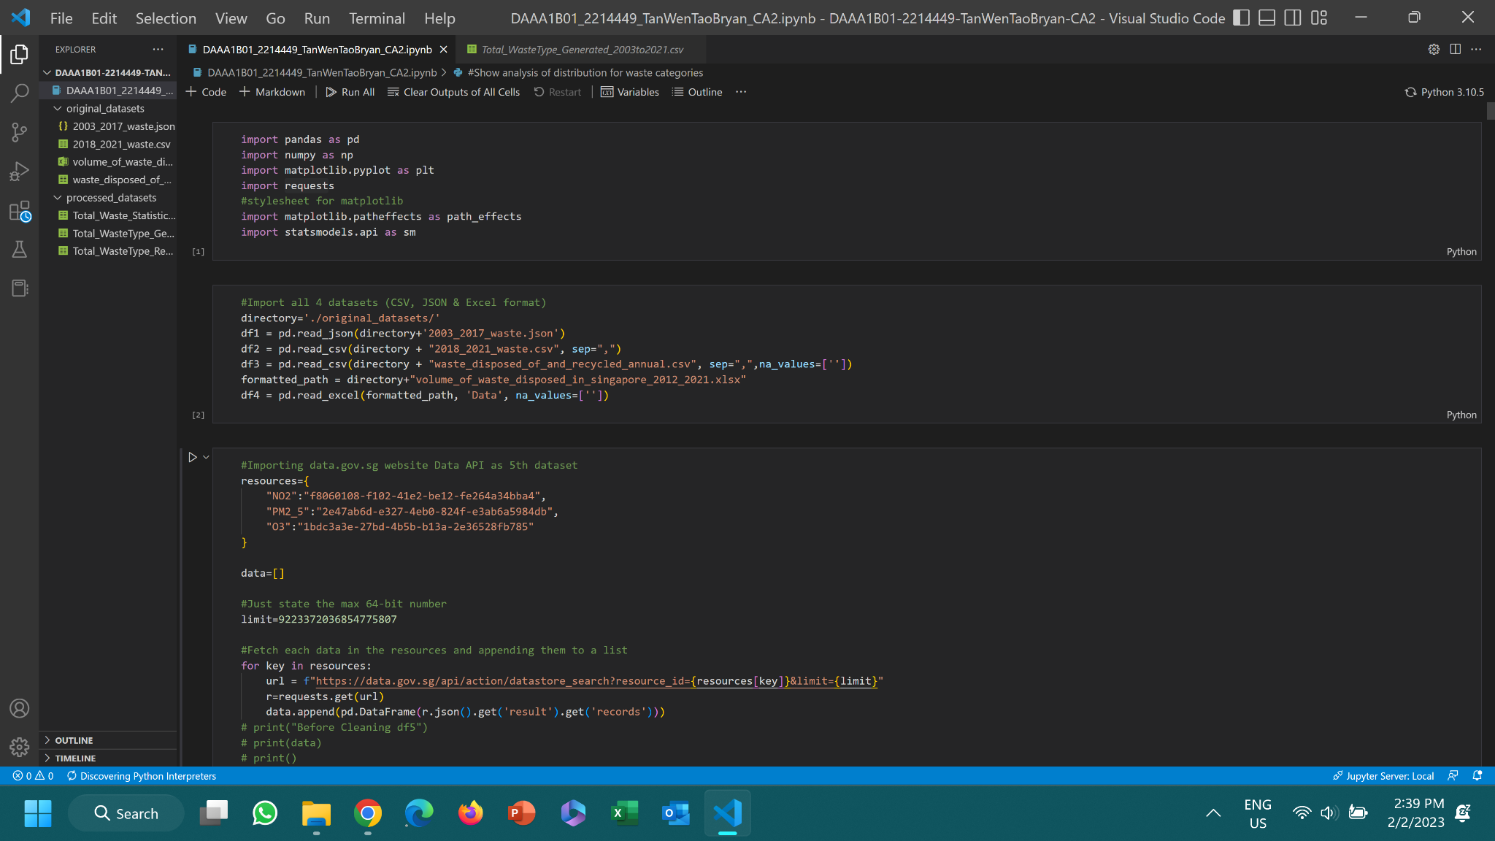
Import Libraries

Slide 7
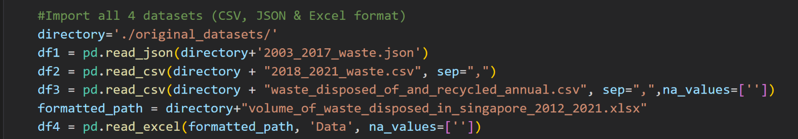
Reading Data
Read data from json, csv and excel files

Slide 8
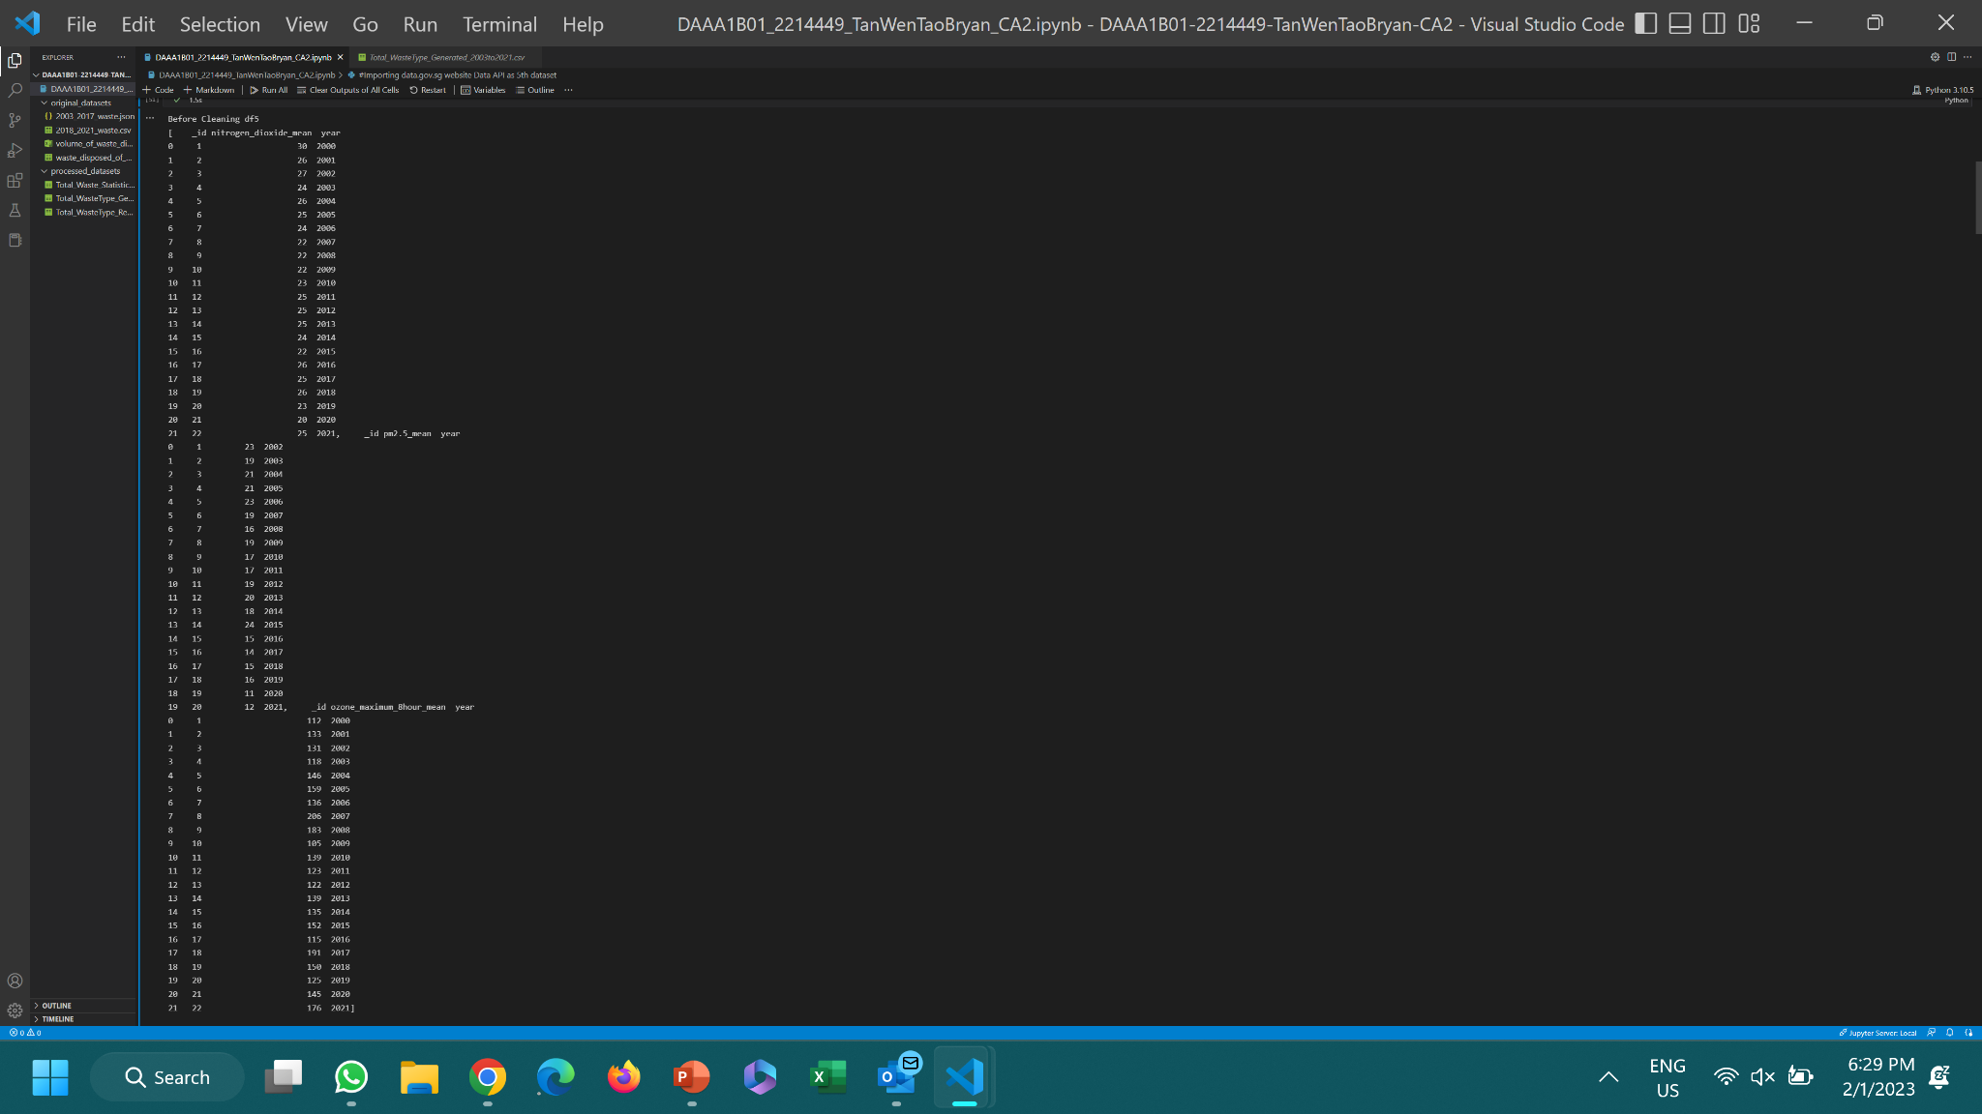
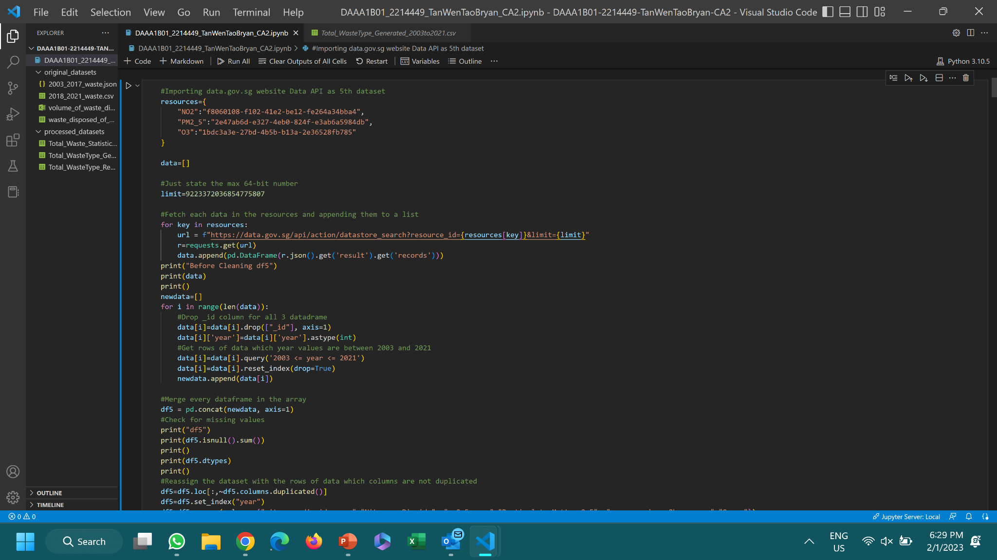
Reading Data
Read data from website API (data.gov.sg) to get the data for air pollutants by their IDs
Import requests as an API to GET the data through the url, max limit specified is max 64 bit number
Append the records of the results as a pandas DataFrame in data which is a list

Slide 9
01.
Dataset 1 & 2
Waste Type from 2003-2021

Slide 10
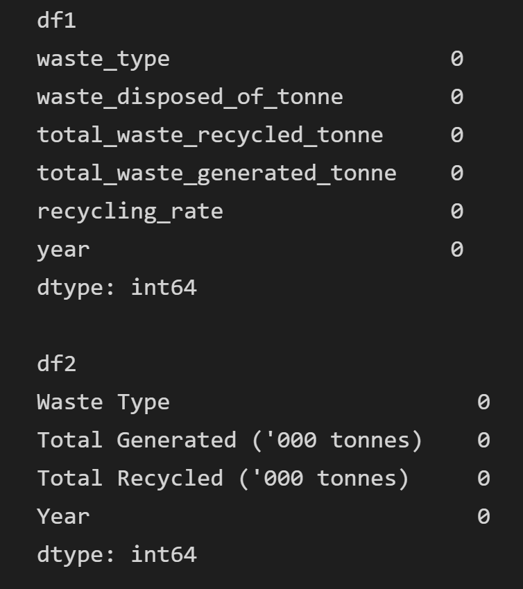
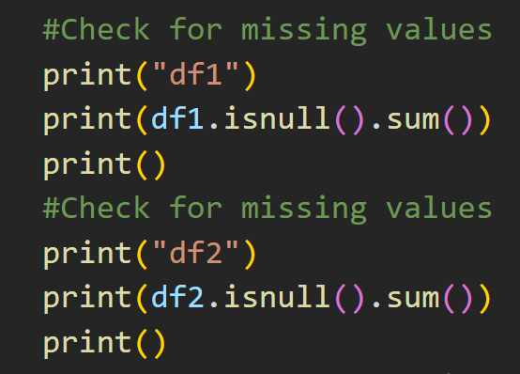
Check for Missing Values

Slide 11
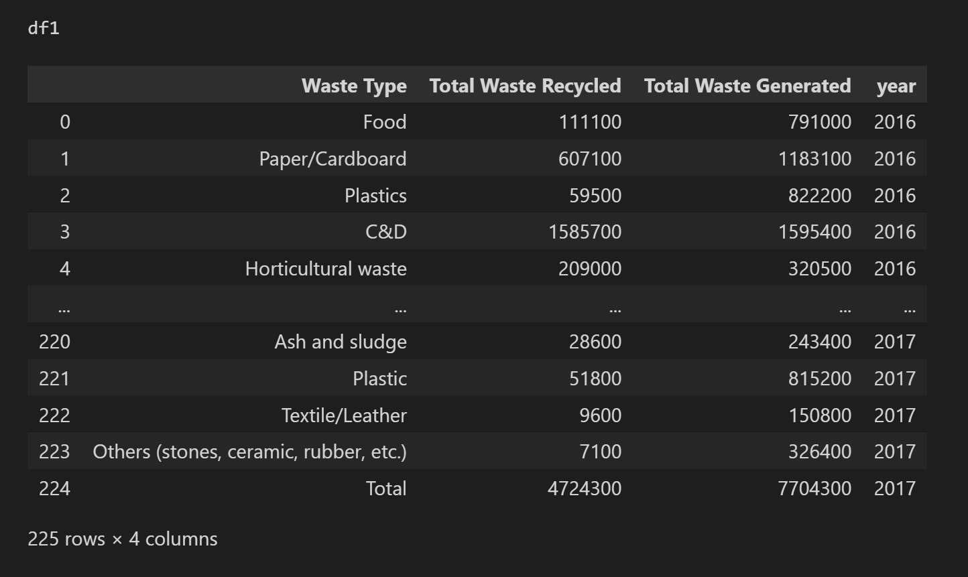
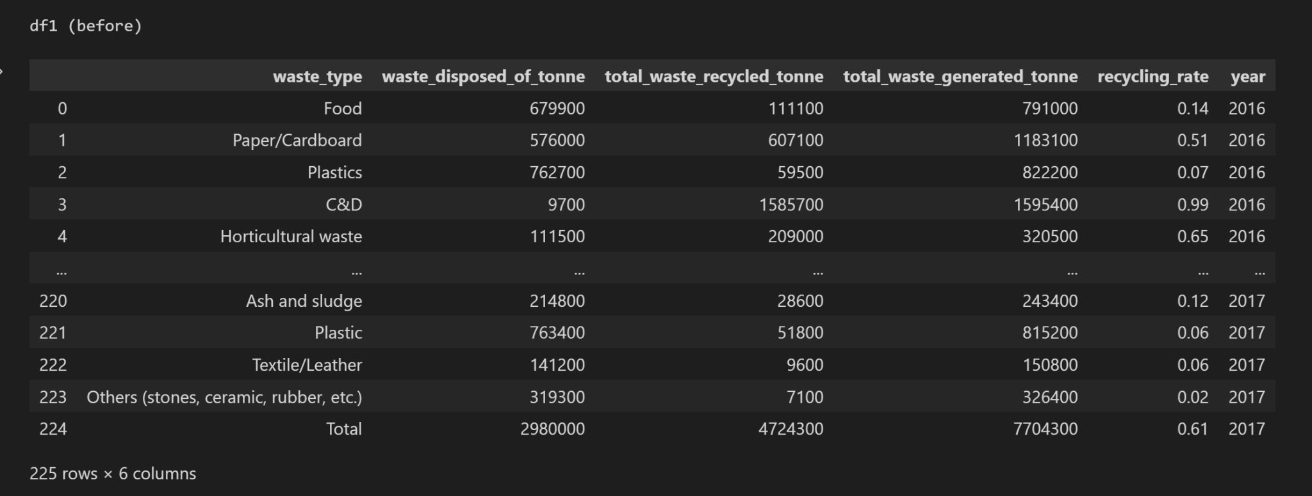
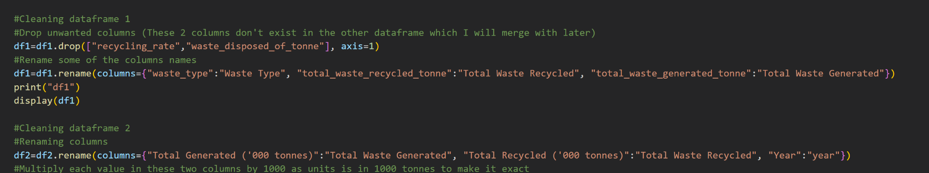
Cleaning df1
After Cleaning:
Before Cleaning:

Slide 12
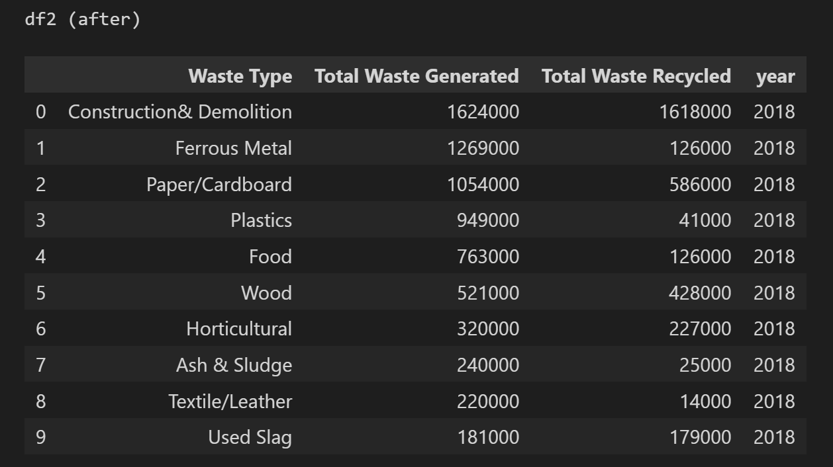
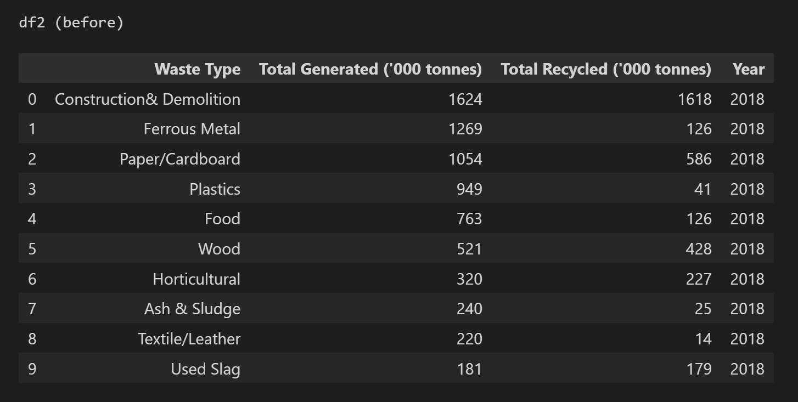
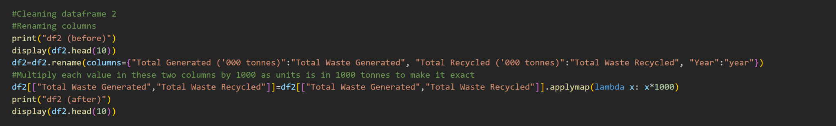
Cleaning df2
After Cleaning:
Before Cleaning:

Slide 13
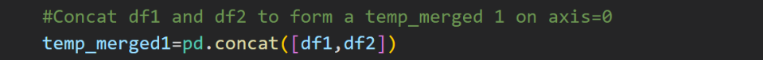
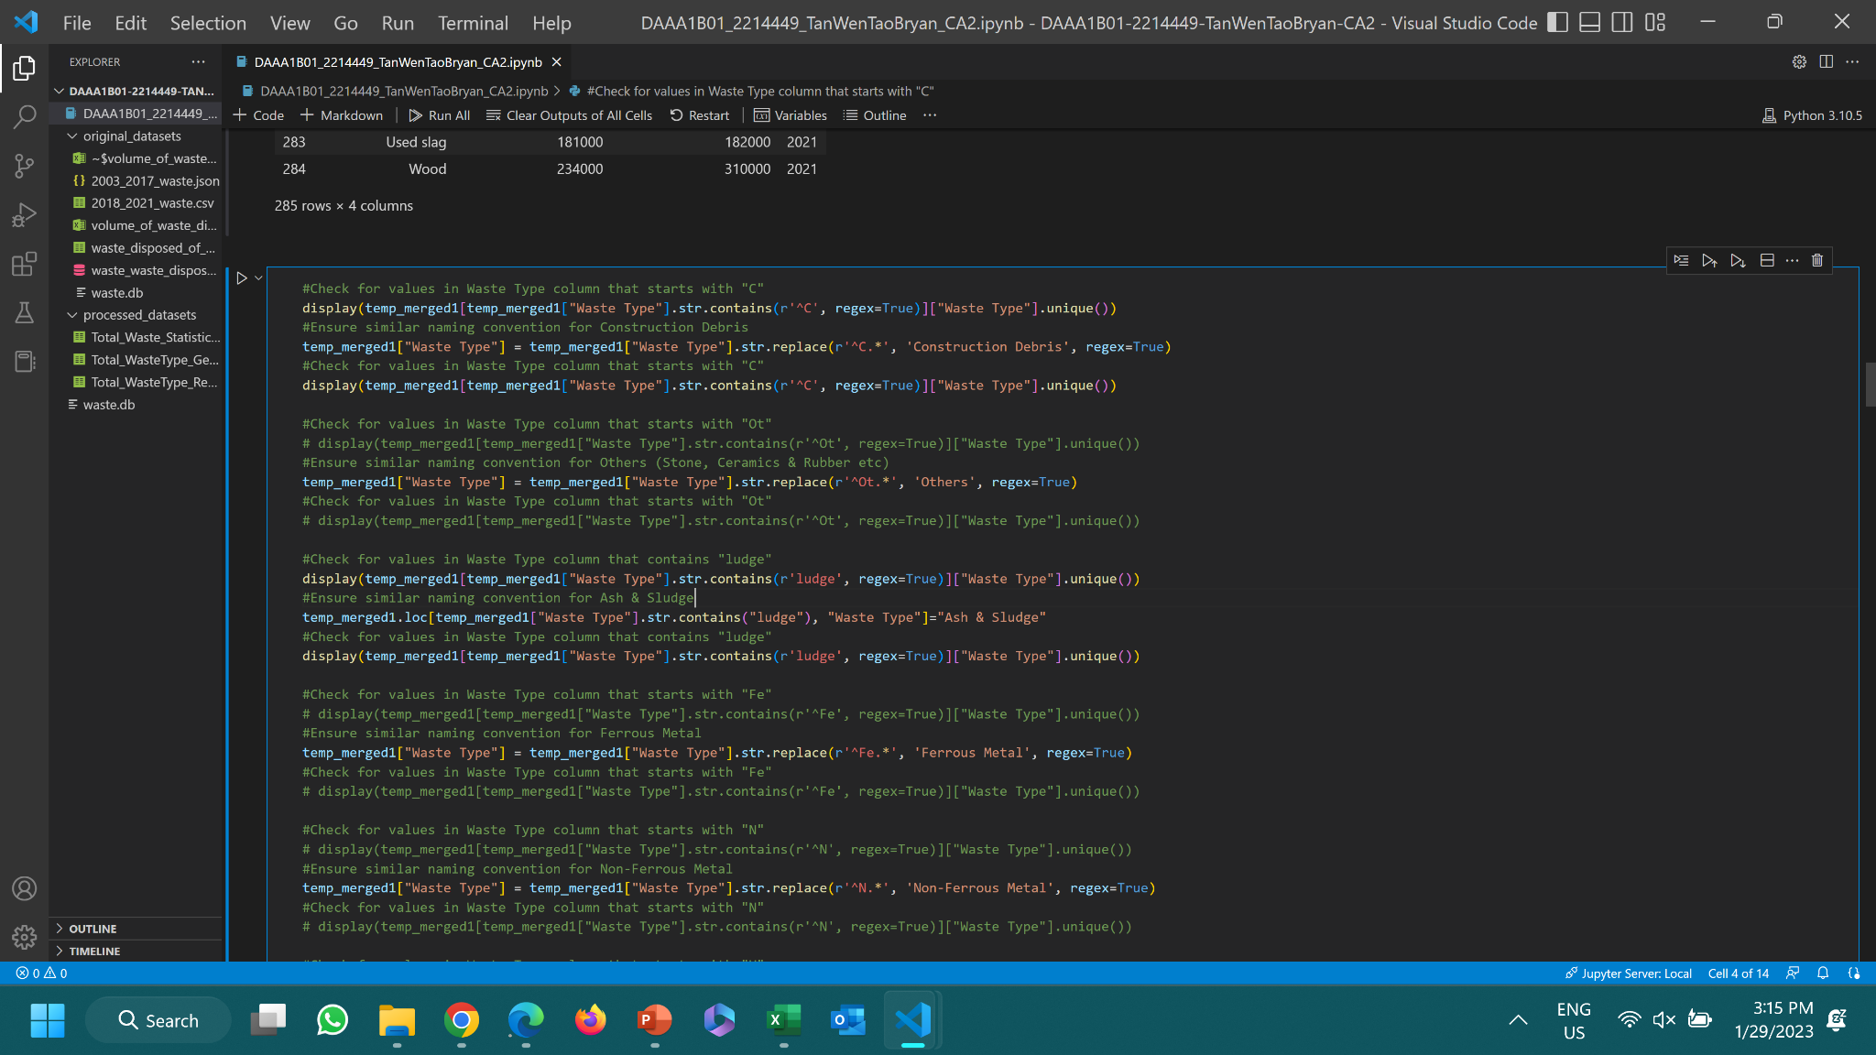
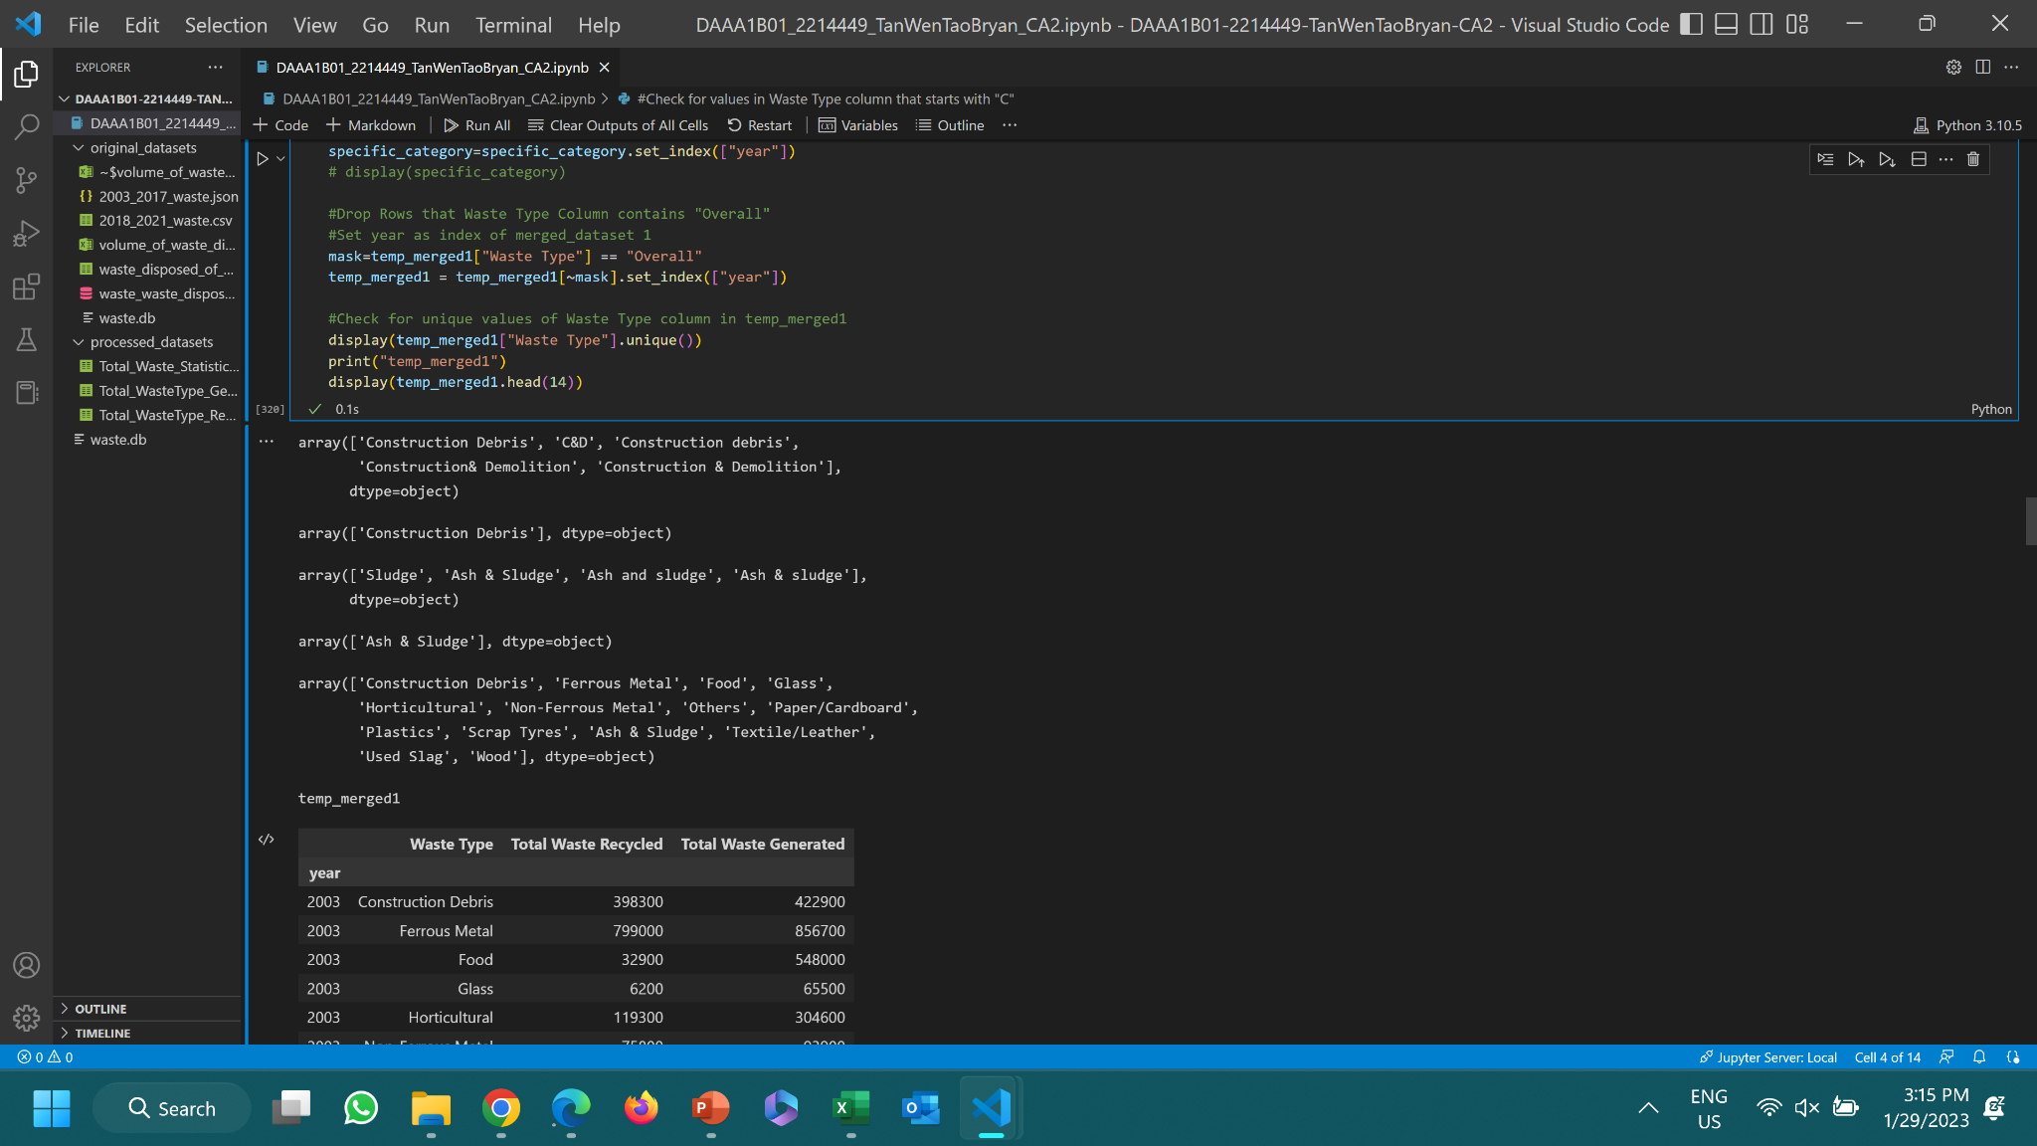
Cleaning temp_merged1
Concatenate df1 and df2 to form temp_merged1
Replace every row of value starting with ‘C’ with ‘Construction Debris’
Replace every row of value containing ‘ludge’ with ‘Ash & Sludge’

Slide 14
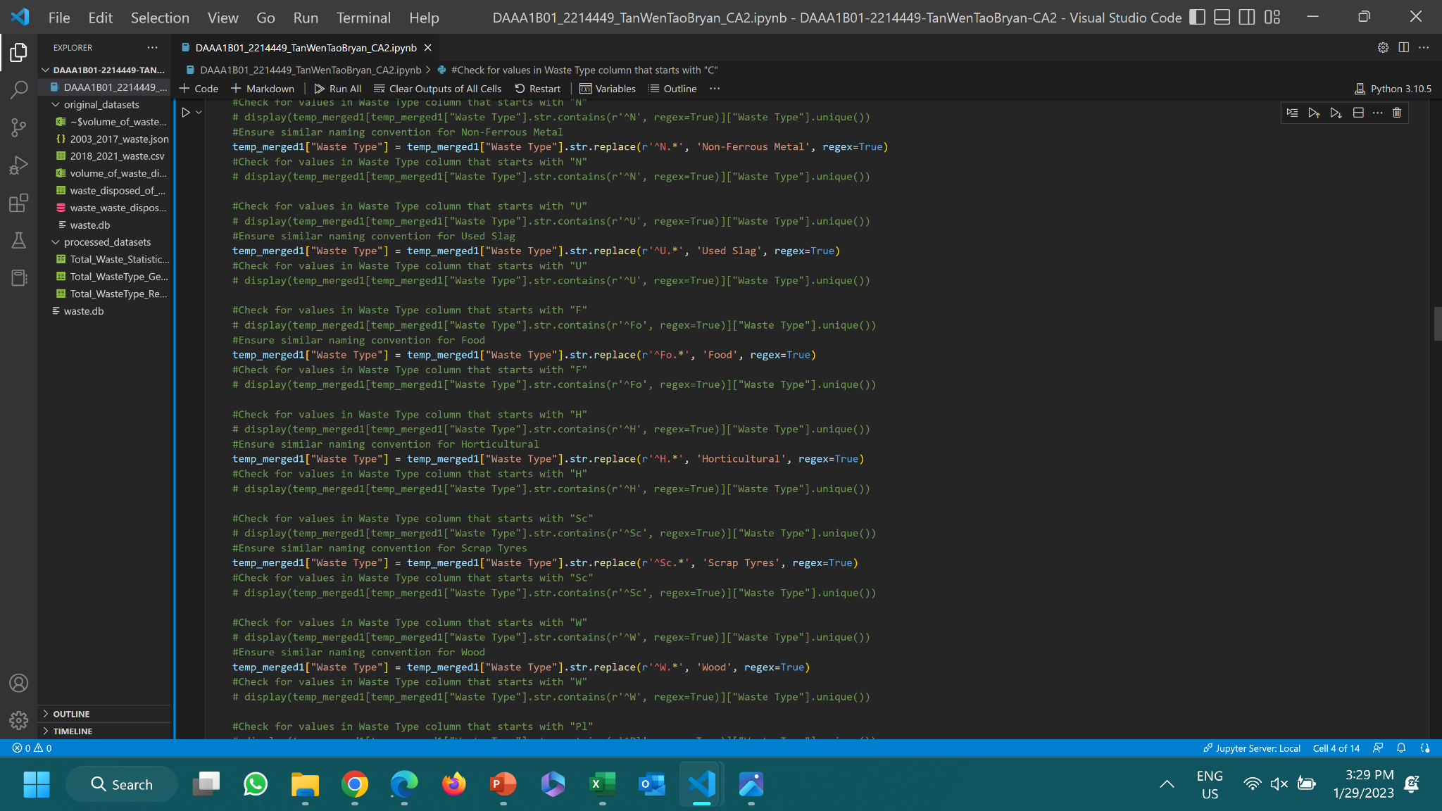
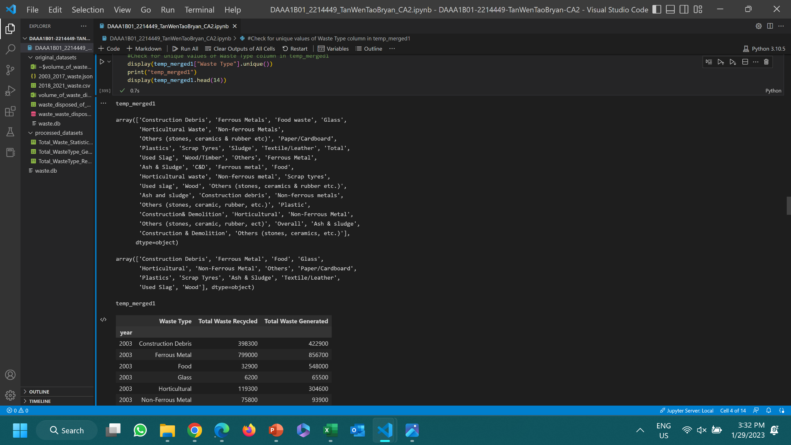
Cleaning temp_merged1
All ‘Waste Type’ values before cleaning
All ‘Waste Type’ values after cleaning

Slide 15
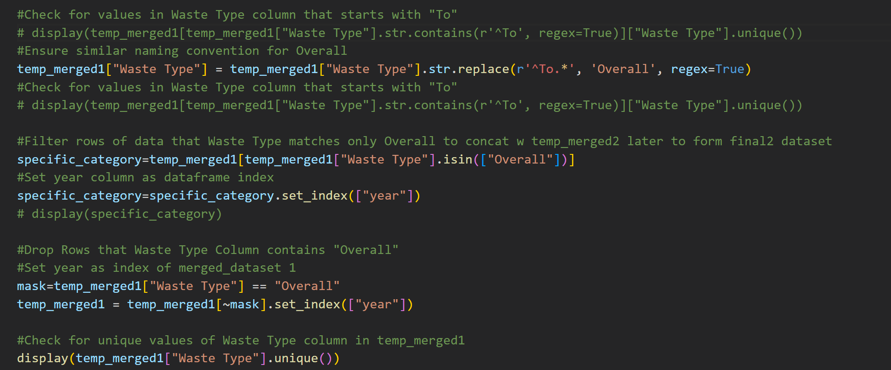
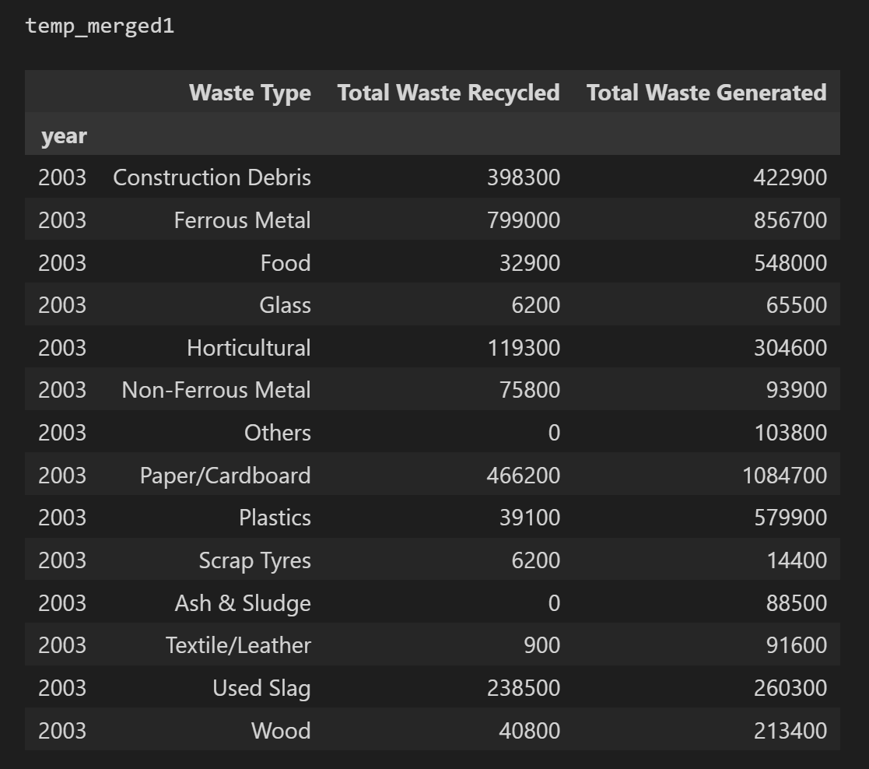
Cleaning temp_merged1
Subset the rows of data which Waste Type is “Overall” to merge with another dataset to form final2 dataset later
Drop rows of data in temp_merged1 which Waste Type is “Overall”
Set “year” as index

Slide 16
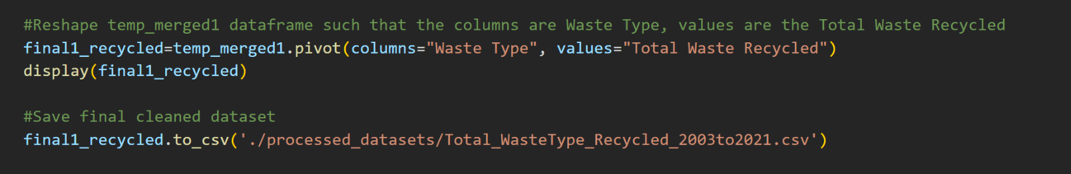
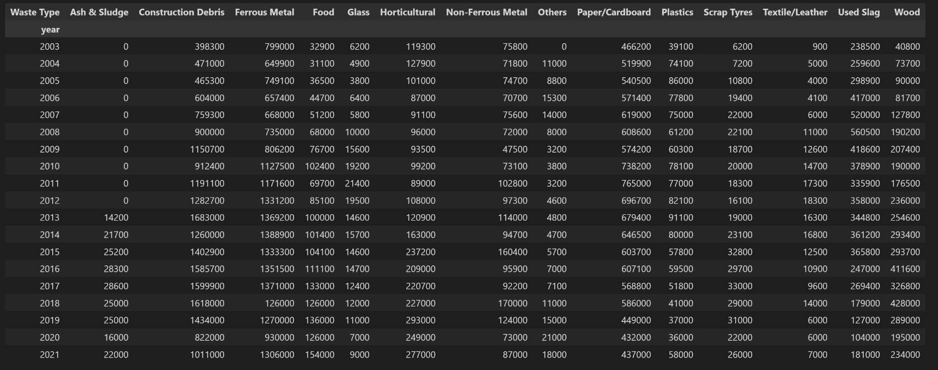
1st Final Dataset: final1_recycled

Slide 17
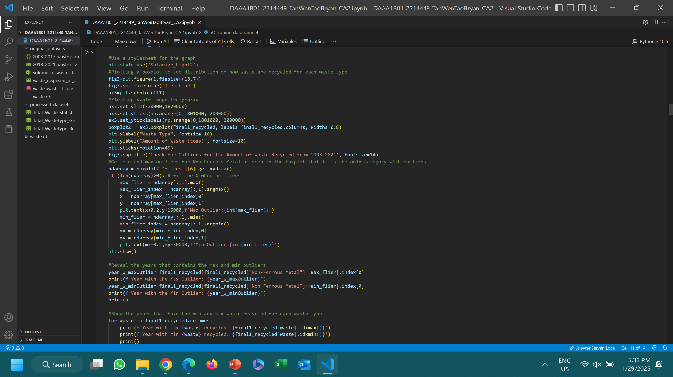
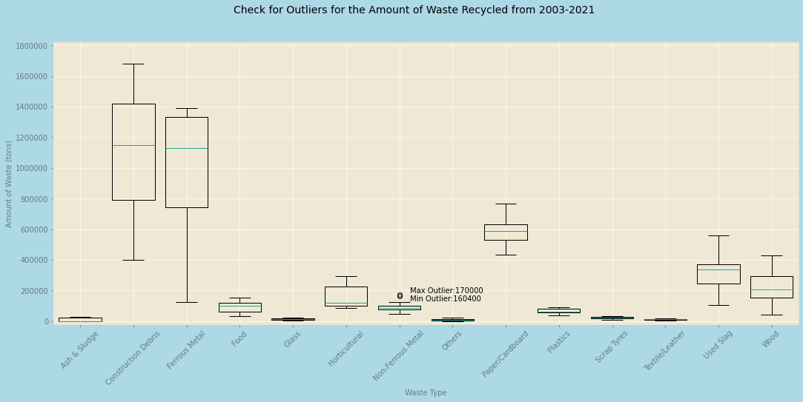
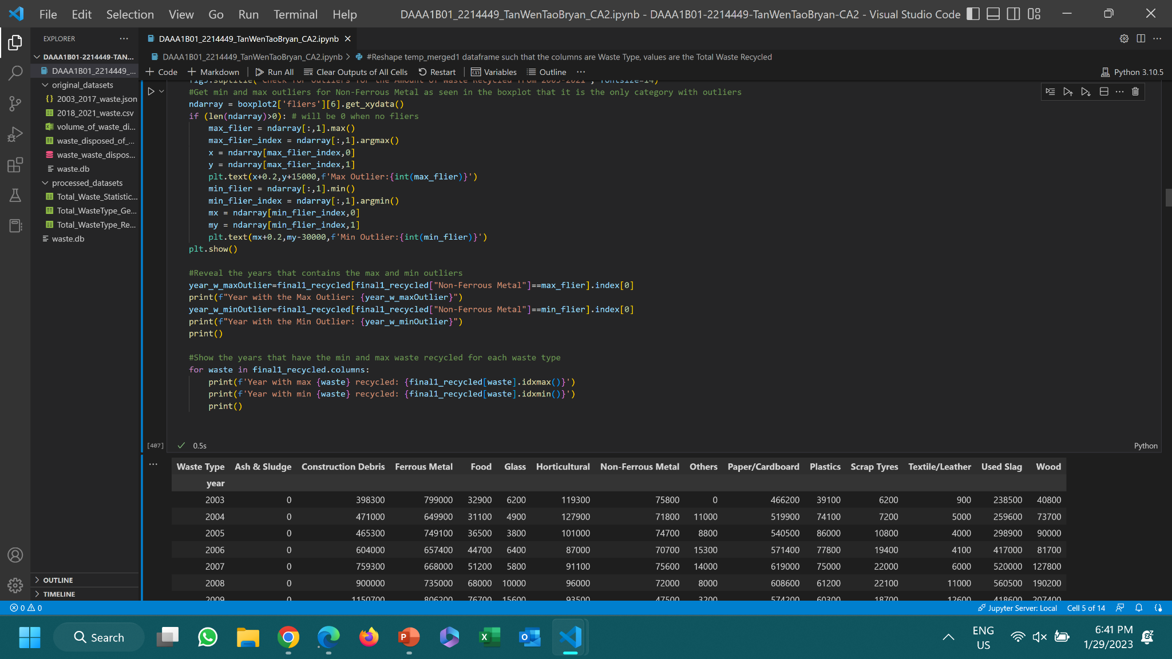
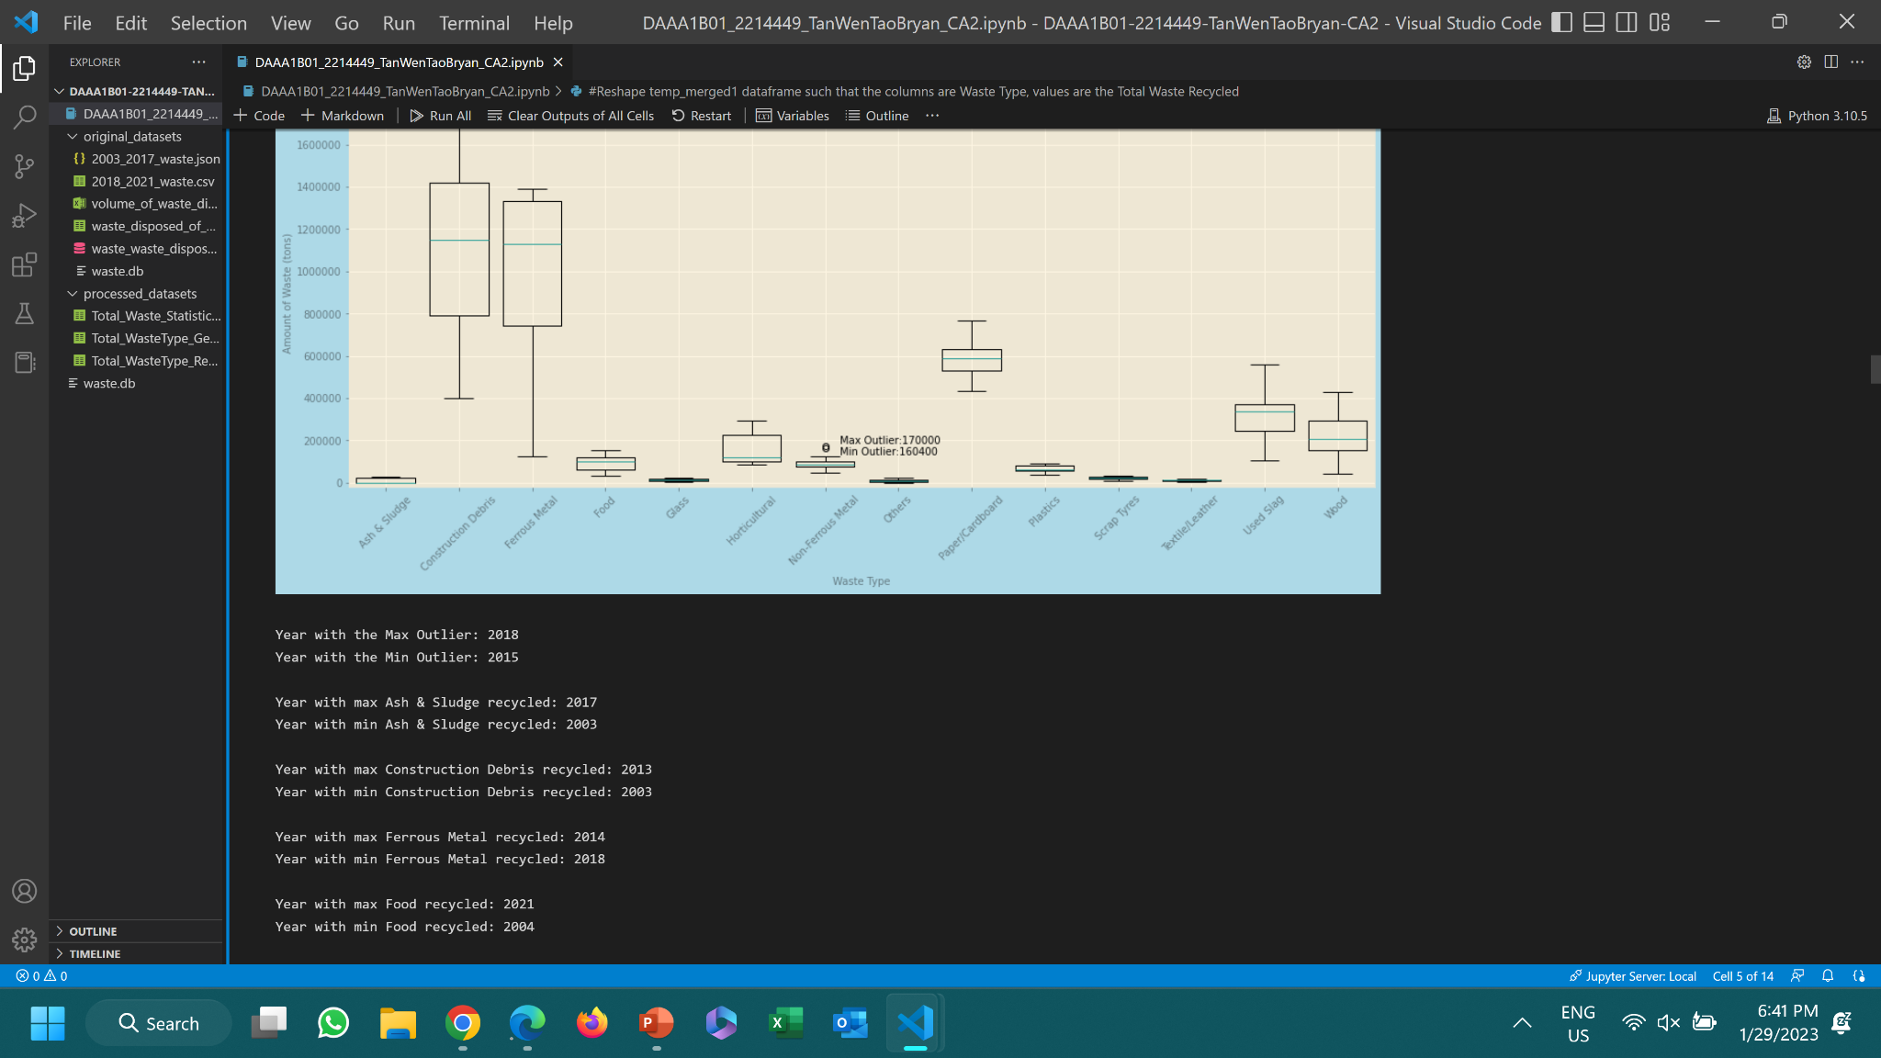
Check for outliers: final1_recycled
Presence of Outliers: Non-Ferrous Metal
Exists in 2018 & 2015
Highest Amount of Waste Type Recycled: Construction Debris
Construction Debris has a symmetrical distribution recycled throughout the years
Low Amount of Waste Type Recycled: Ash & Sludge, Others, Textile/Leather, Glass, Scrap Tyres
Ash & Sludge was not recycled for the first few years.
Textile/Leather & Others generally have higher waste disposed than recycled.
Glass & Scrap Tyres have a low number of waste generated

Slide 18
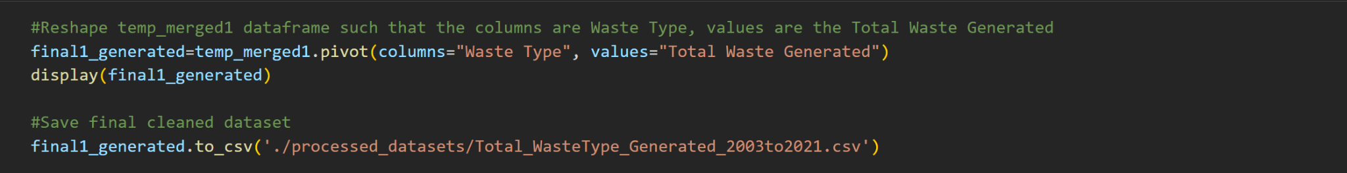
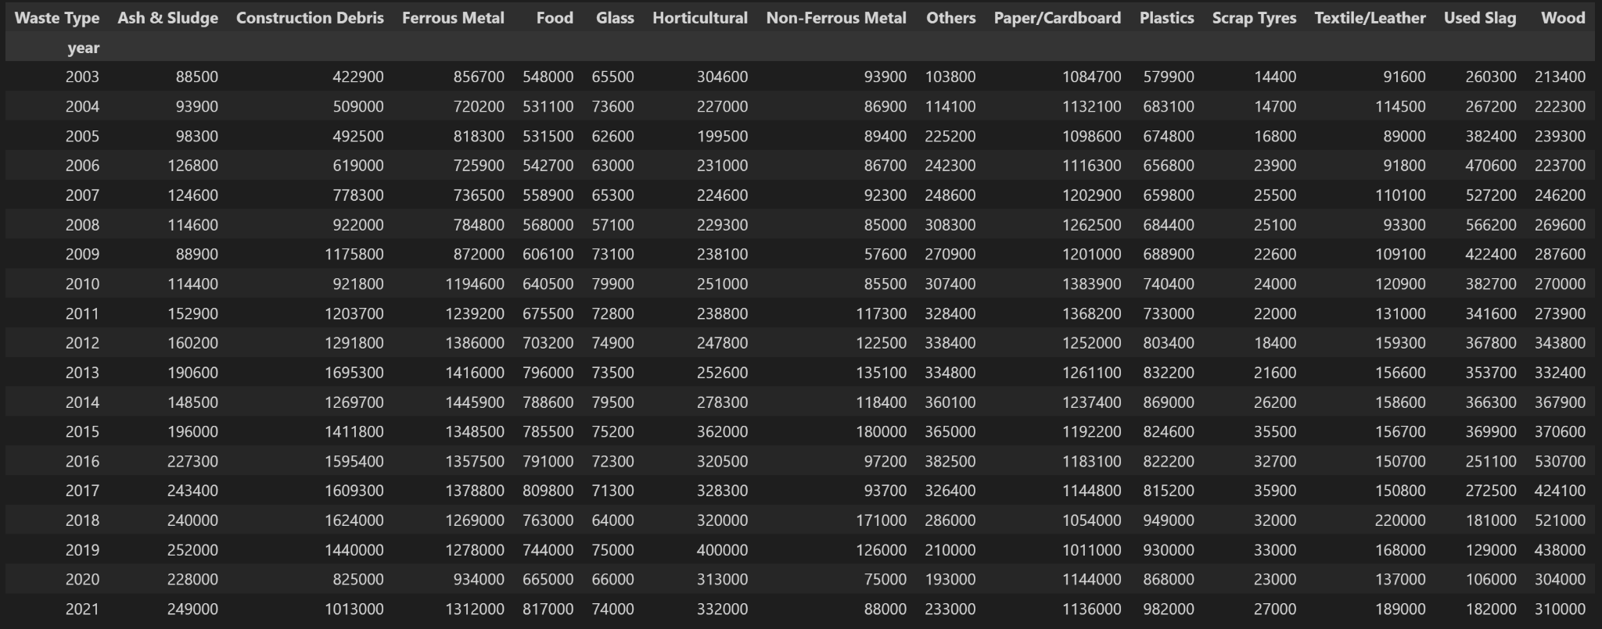
2nd Final Dataset: final1_generated

Slide 19
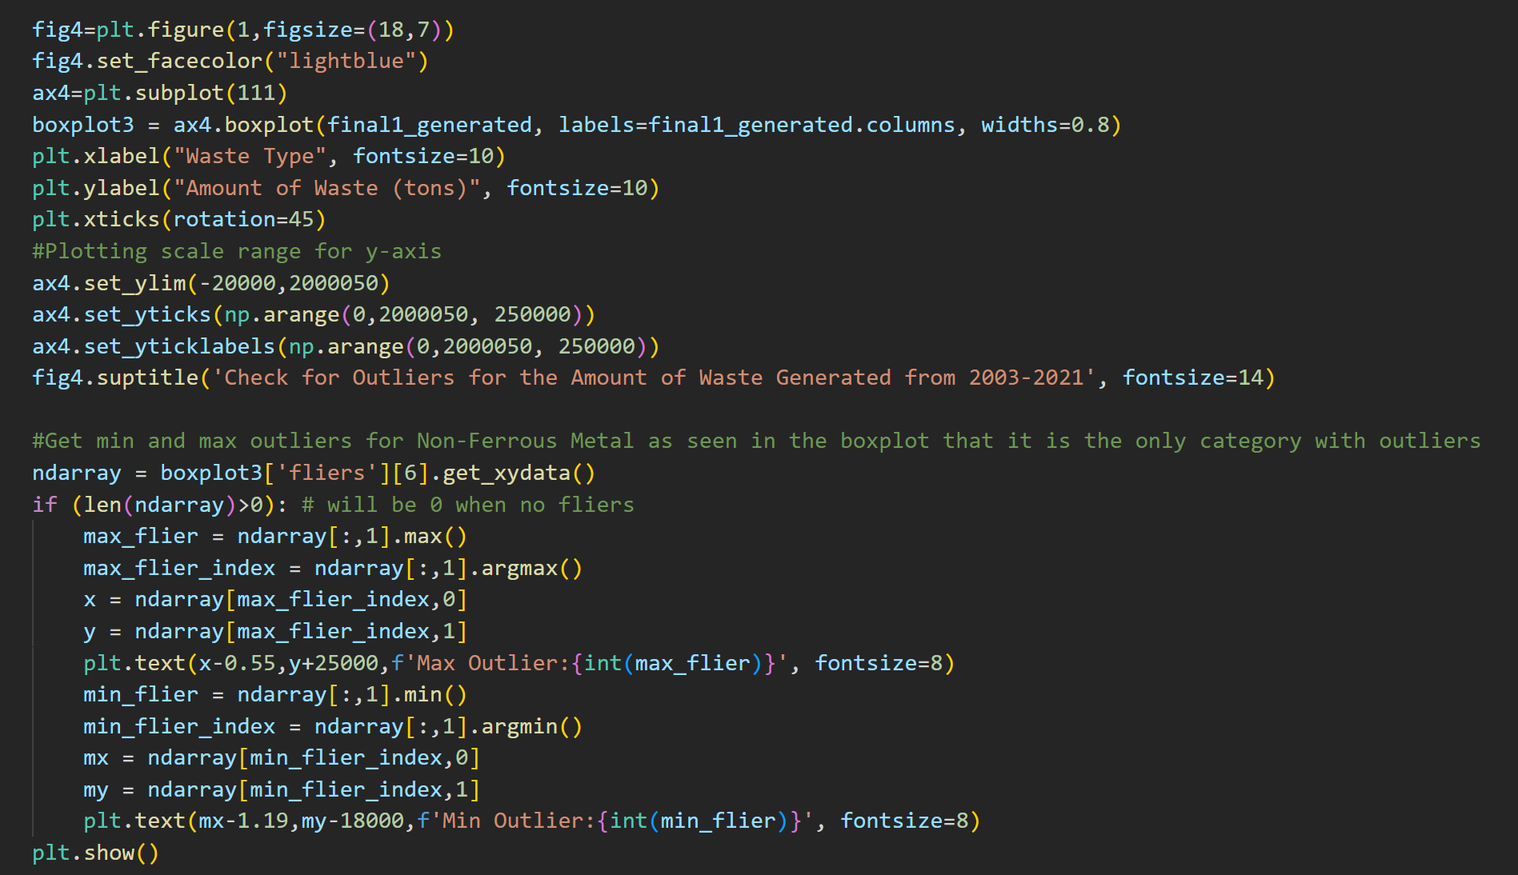
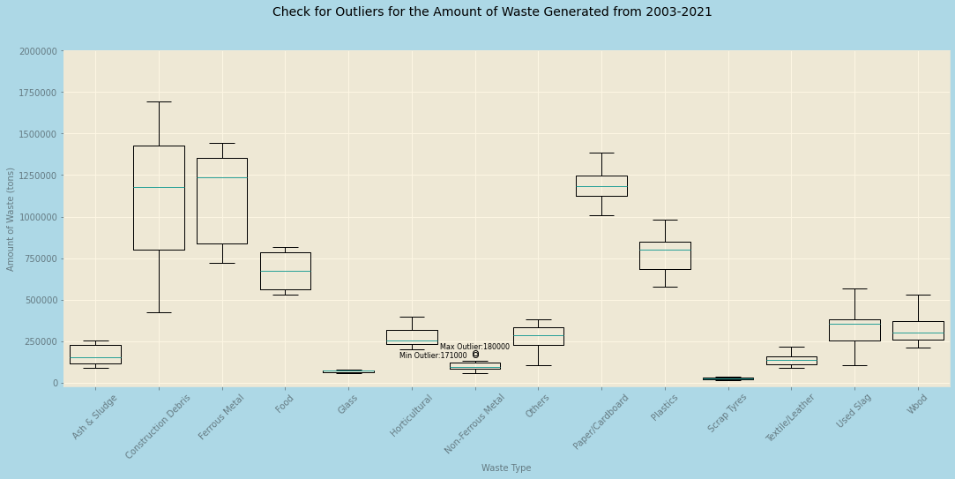
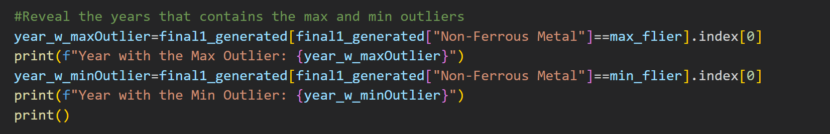
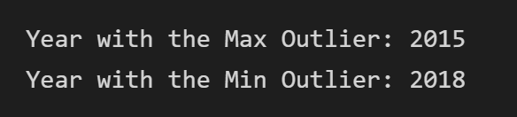
Check for outliers: final1_generated
Presence of Outliers: Non-Ferrous Metal
Exists in 2015 & 2018 (Due to higher waste disposed than other years)
Highest Amount of Waste Type Generated: Ferrous Metal
Also has a smaller interquartile range than Construction Debris
Lower Amount of Waste Type Generated: Scrap Tyres, Glass
Causes Scrap Tyres & Glass to have a low number of waste recycled

Slide 20
02.
Dataset 3, 4 & 5
Overall Waste Statistics from 2003-2021 (Recycled, Generated, Disposed) & Mean Amount of Air Pollutants (NO2, PM 2.5, O3)

Slide 21
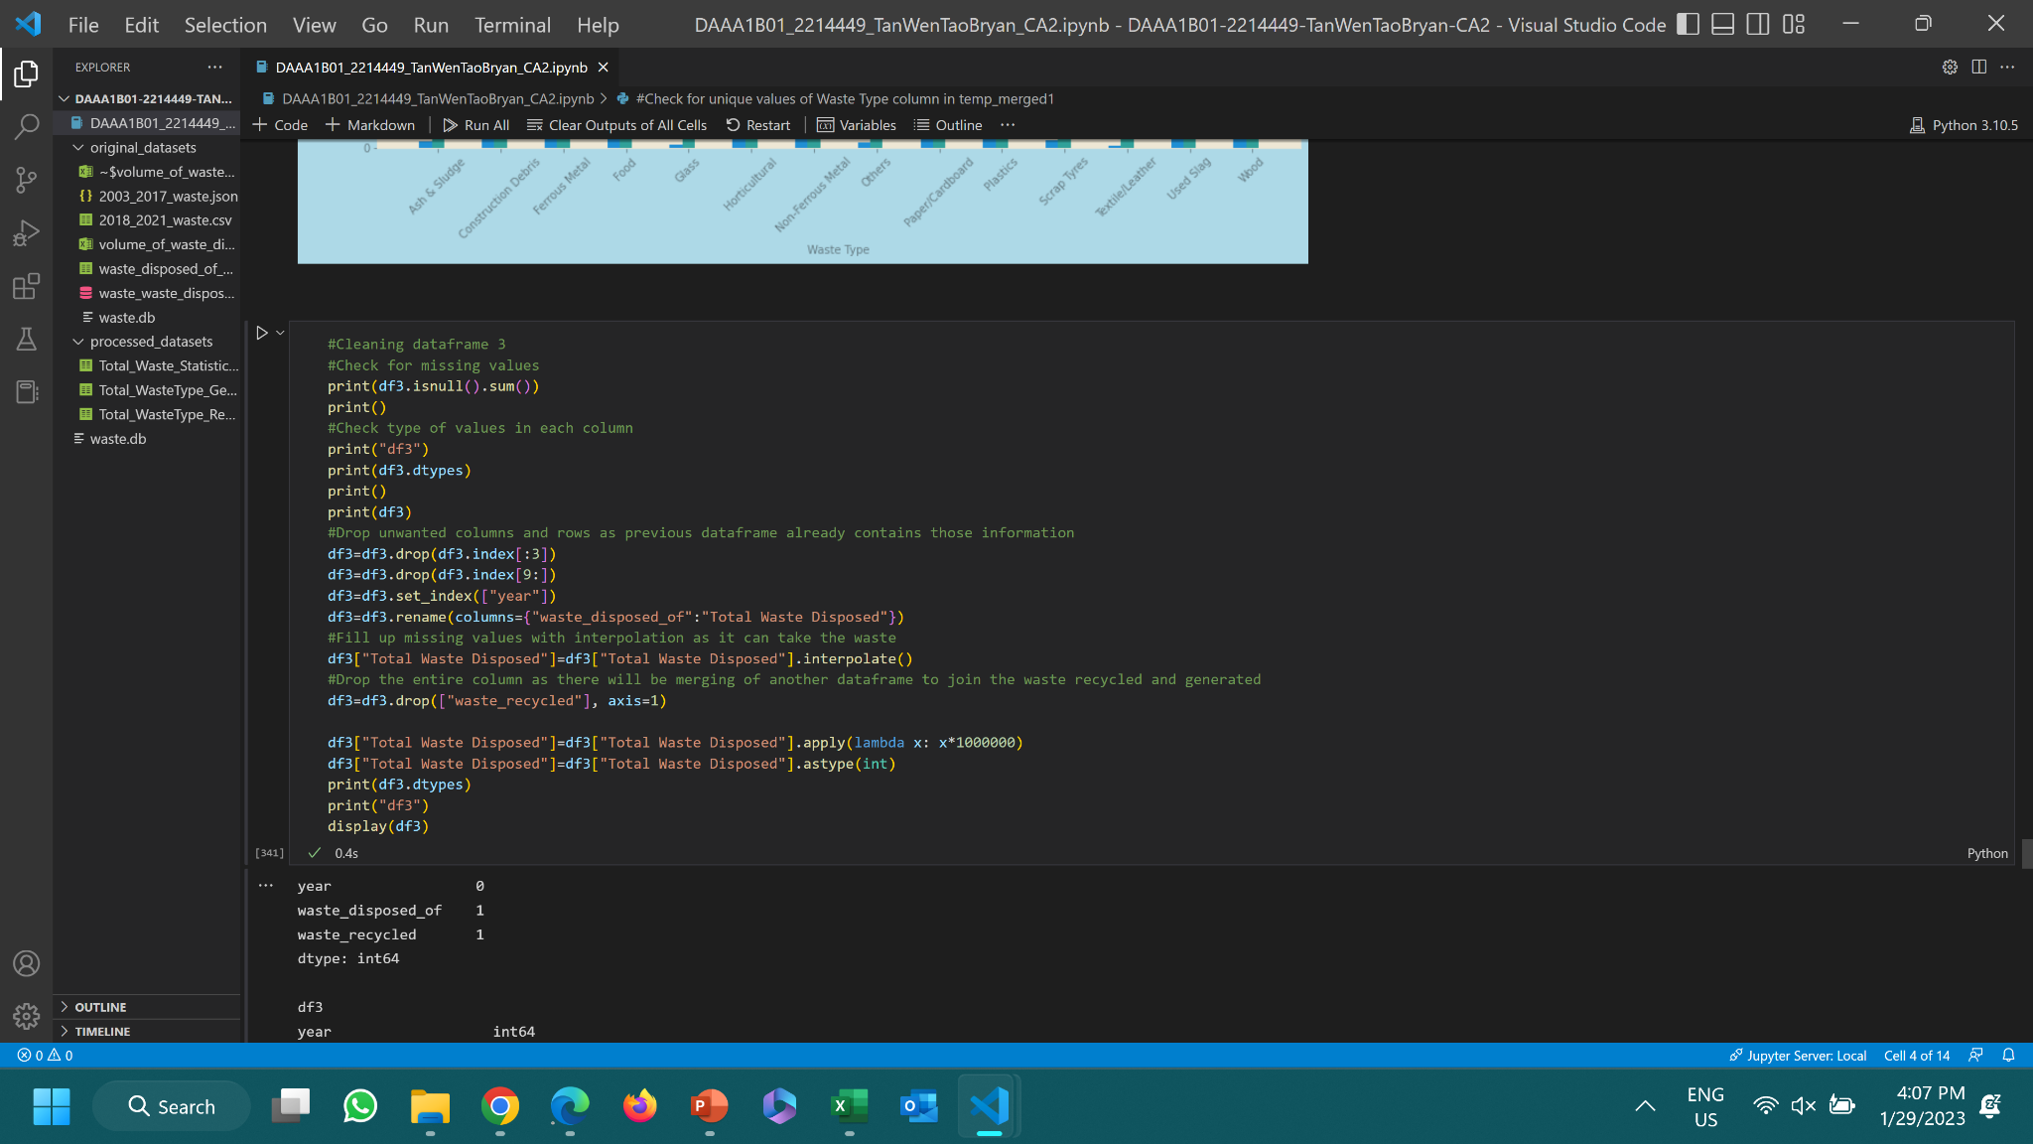
Check for Missing Values (df3)
There are missing values in df3

Slide 22
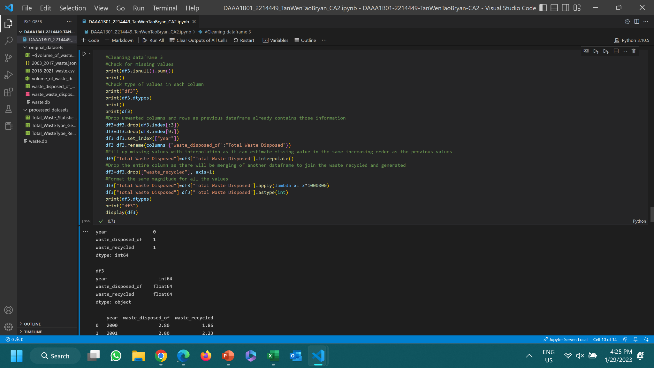
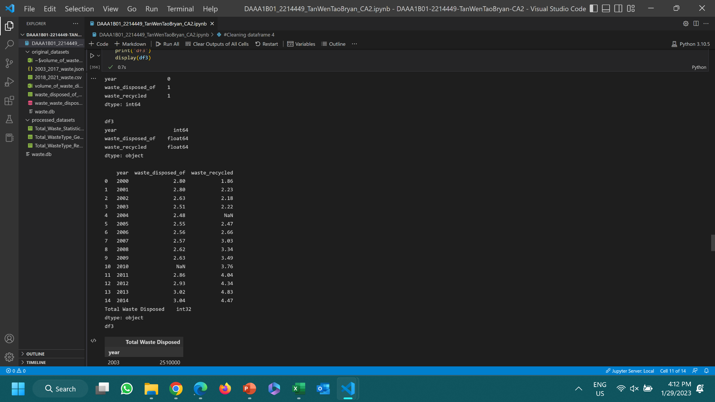
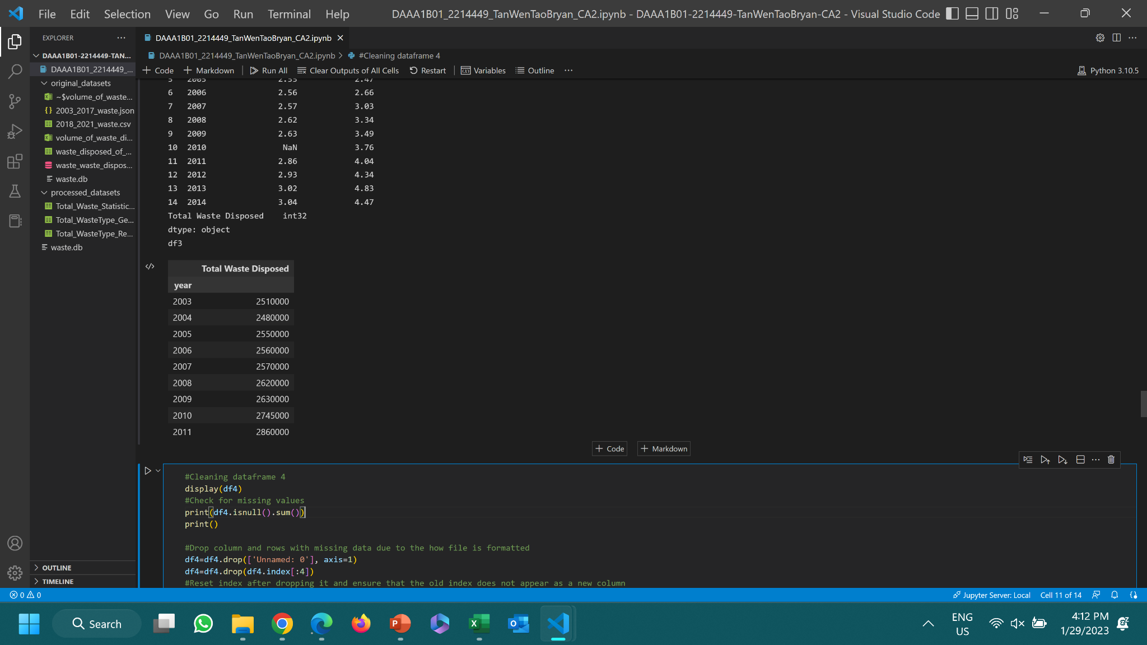
Cleaning df3
Before Cleaning:
After Cleaning:
Linear interpolation is used as it is estimating a missing value in the same increasing order as the previous values, which fits in this data as seen here.

Slide 23
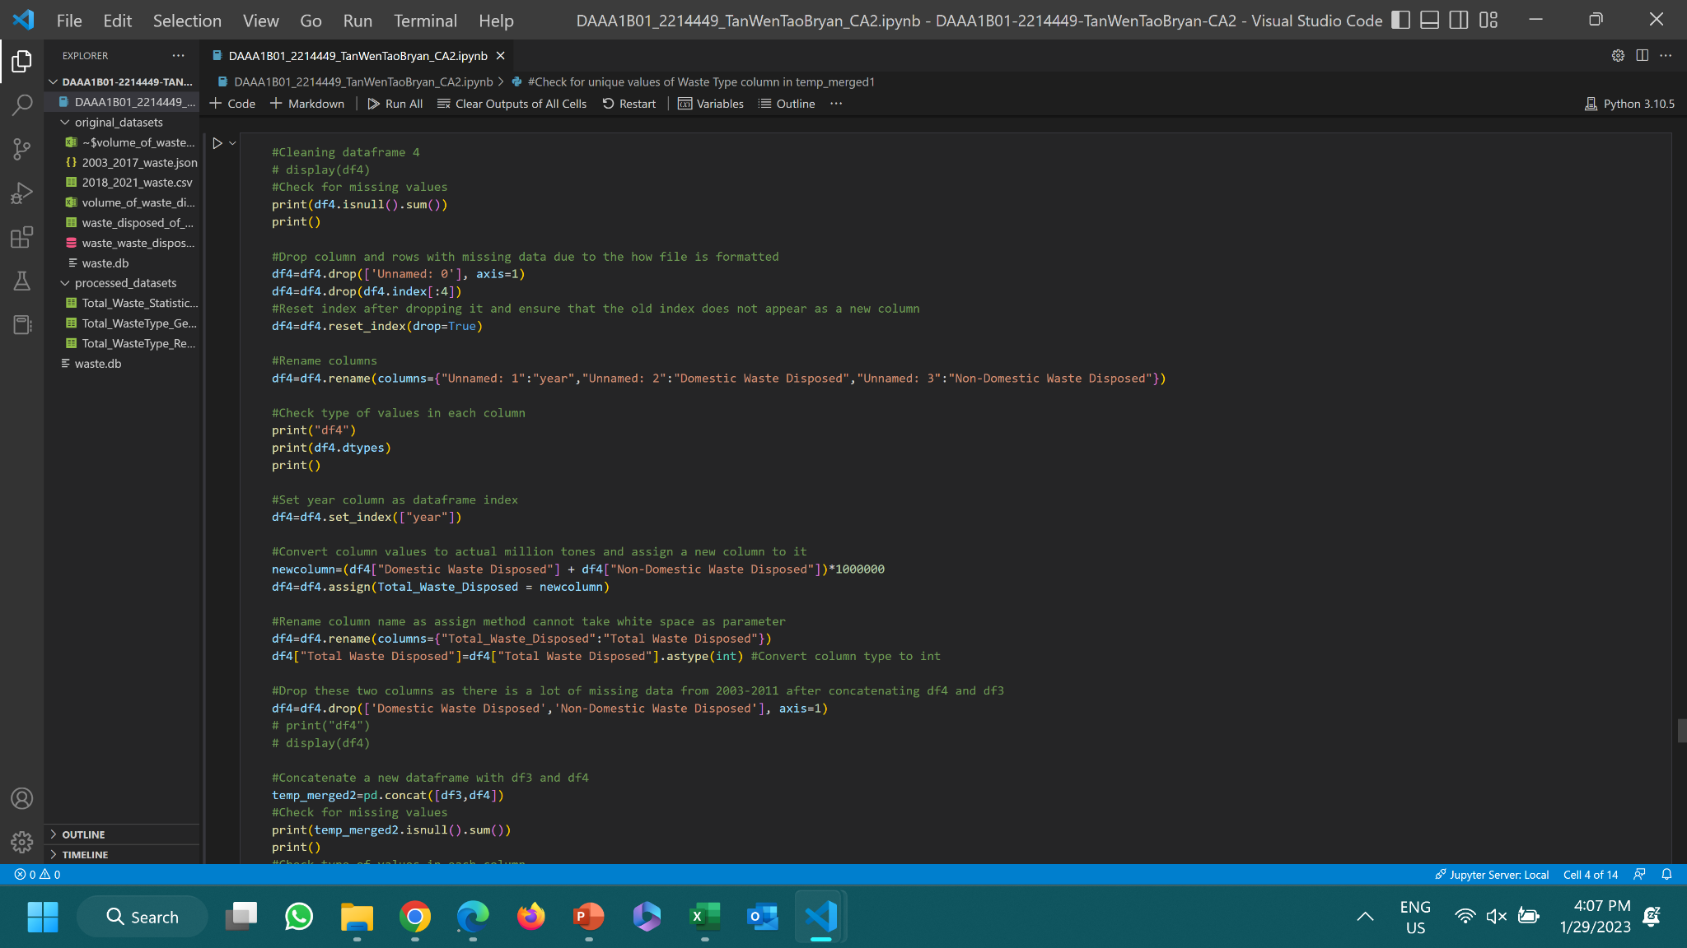
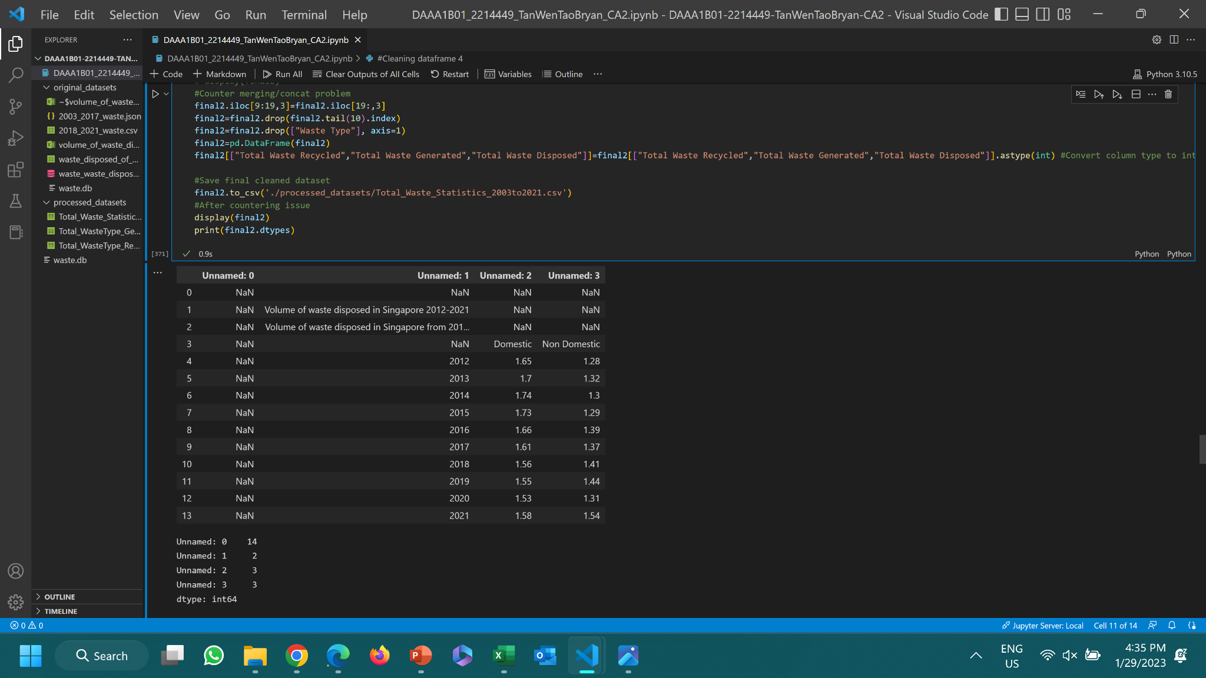
Cleaning df4
Dropping columns and rows to reshape how data frame is being formatted when being imported
Reset index

Slide 24
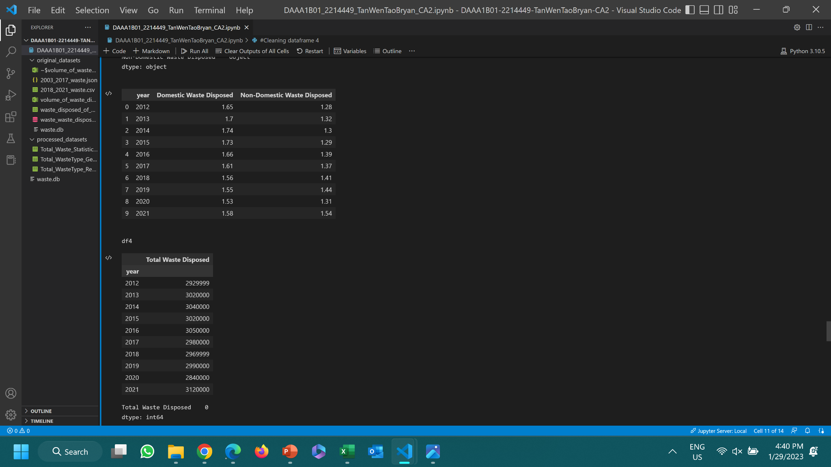
Cleaning df4
Can’t use Domestic & Non-Domestic waste disposal as there is insufficient data from previous years (only use them to get total waste disposed)
After Cleaning:
Before Cleaning:
Missing Values Checked:

Slide 25
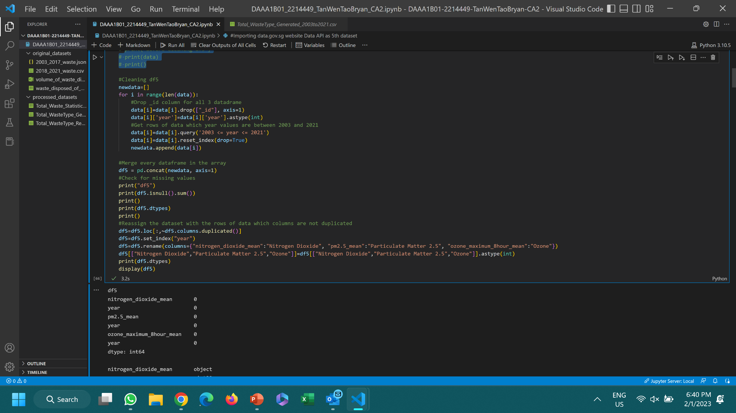
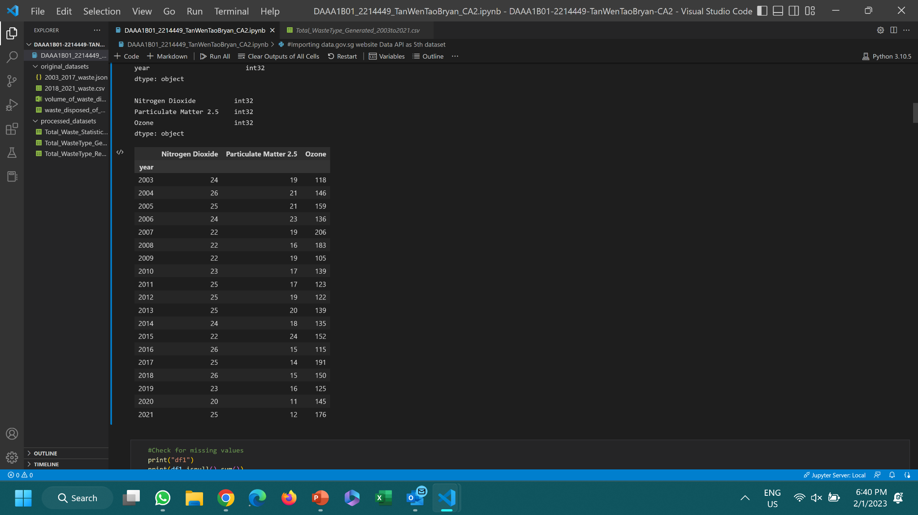
Cleaning df5
Check for missing values
df5
Drop unwanted columns
Convert column type to int
Fetch rows of data between 2003 & 2021 for the ‘year’ column
Check for missing values
Reassign the dataset with the rows of data which columns are not duplicated
Rename column names

Slide 26
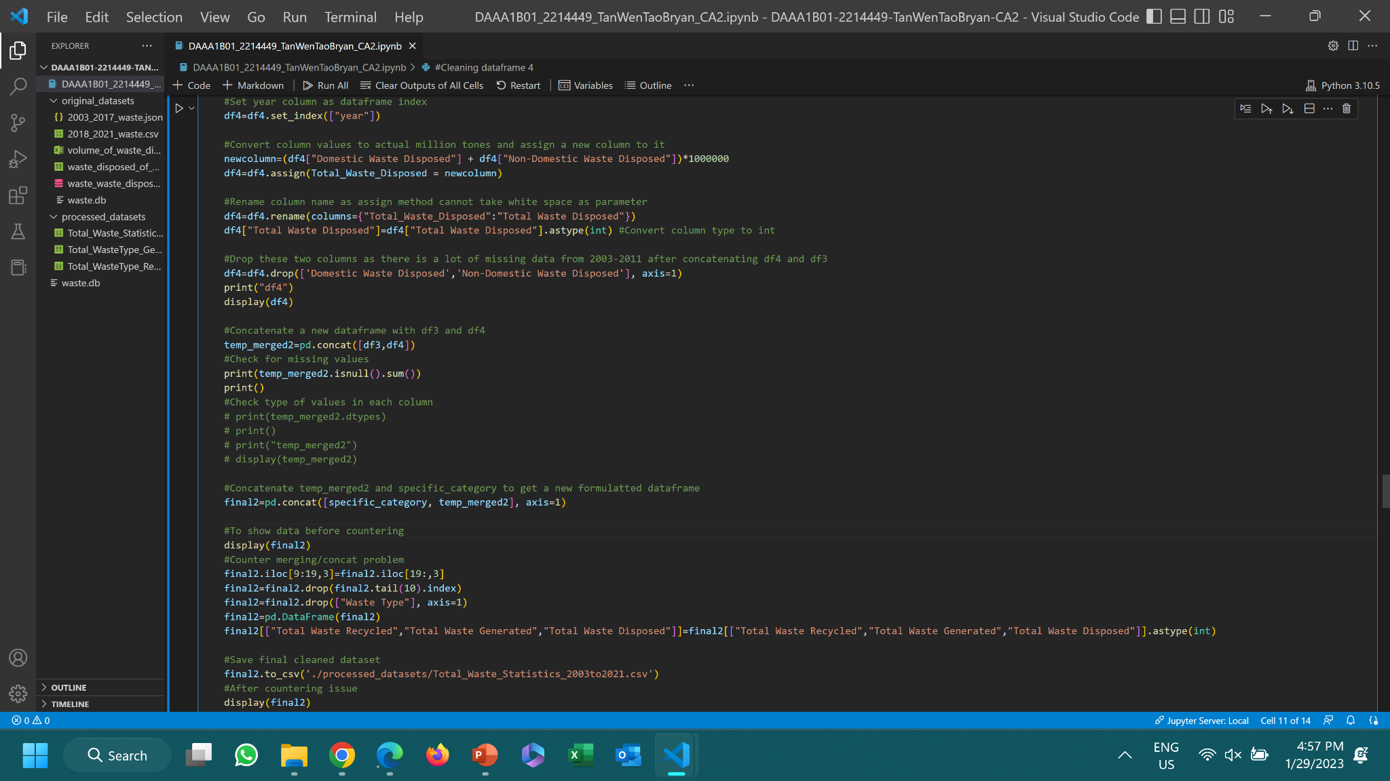
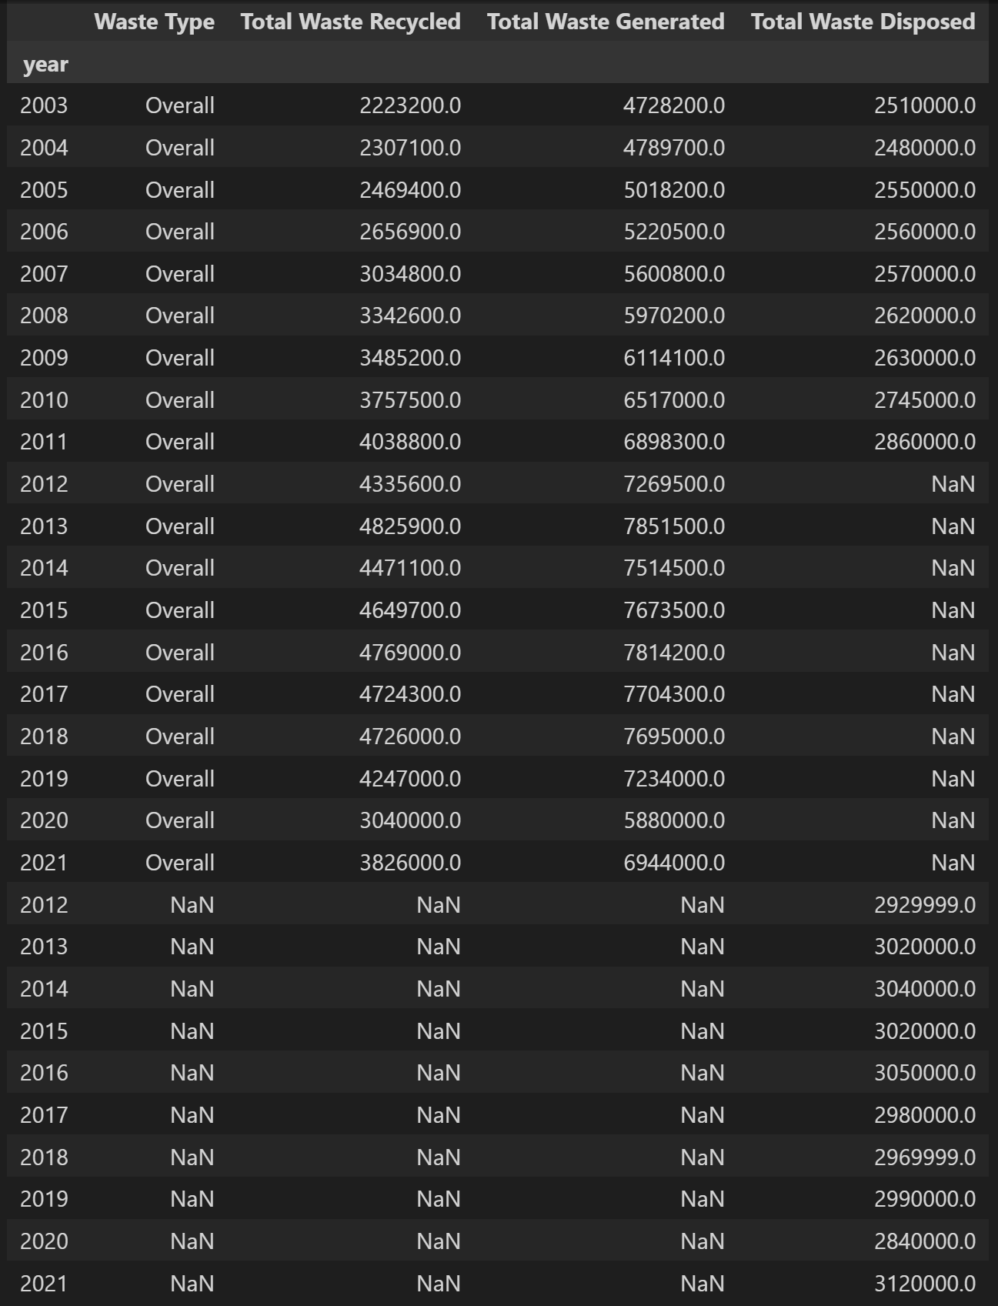
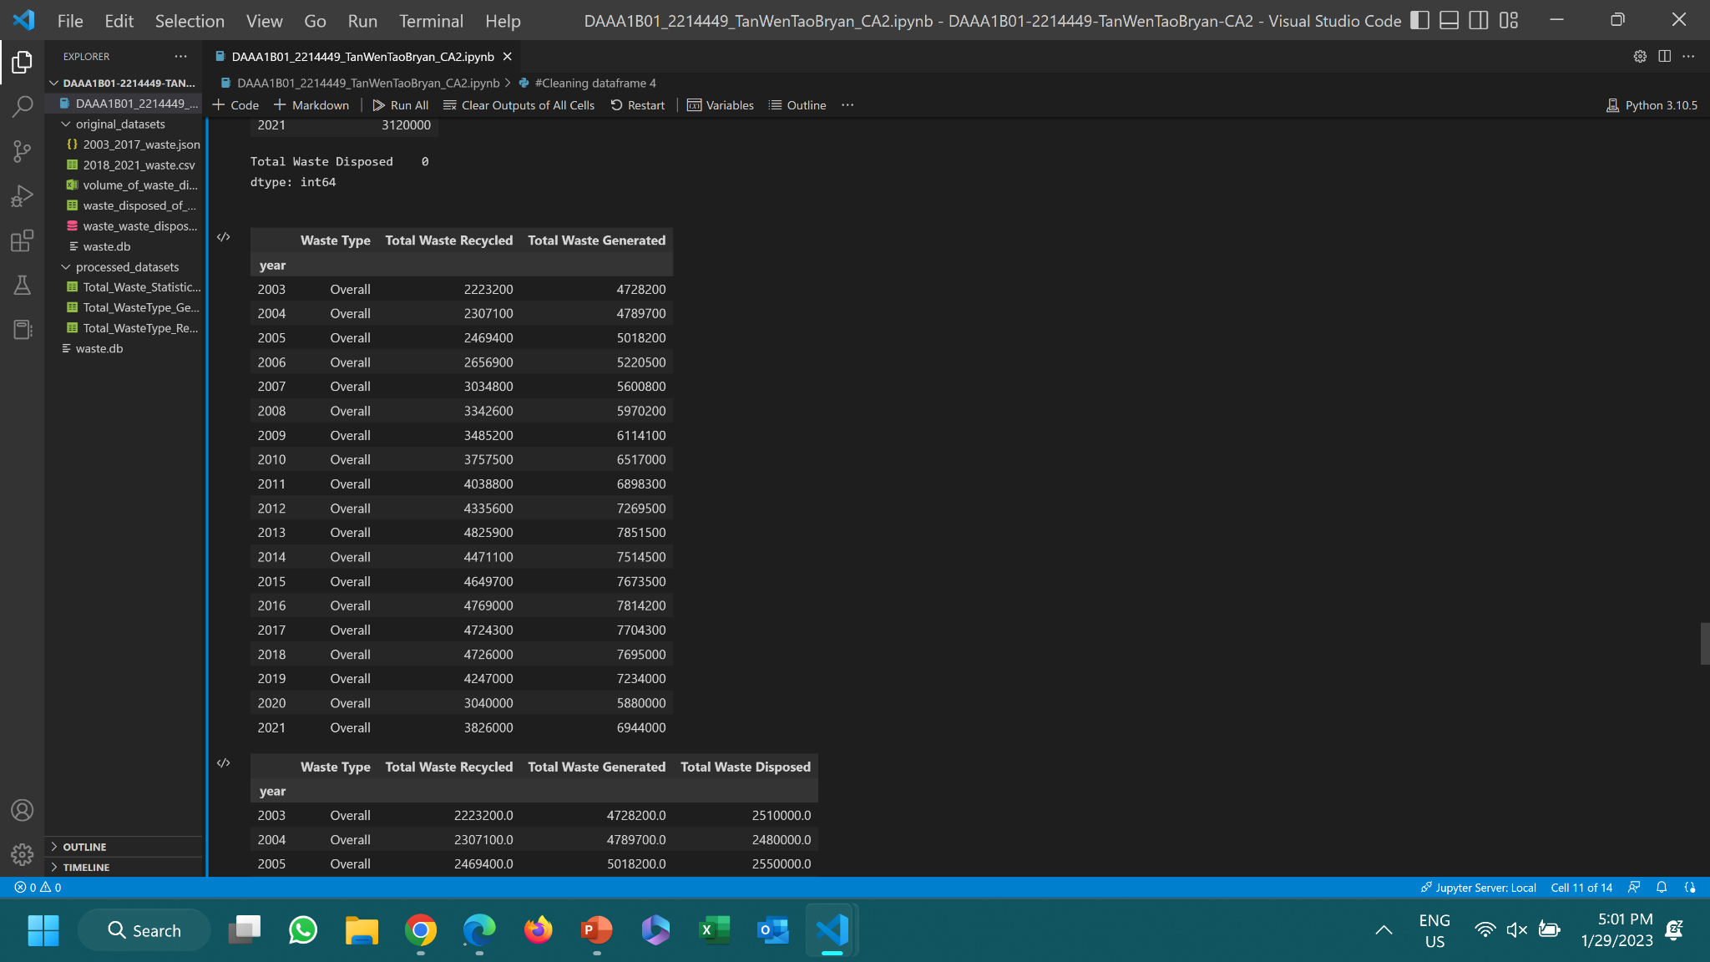
Cleaning temp_merged2
special_category:
Encountered an issue, this is not how I expected the dataframe to look like:

Slide 27
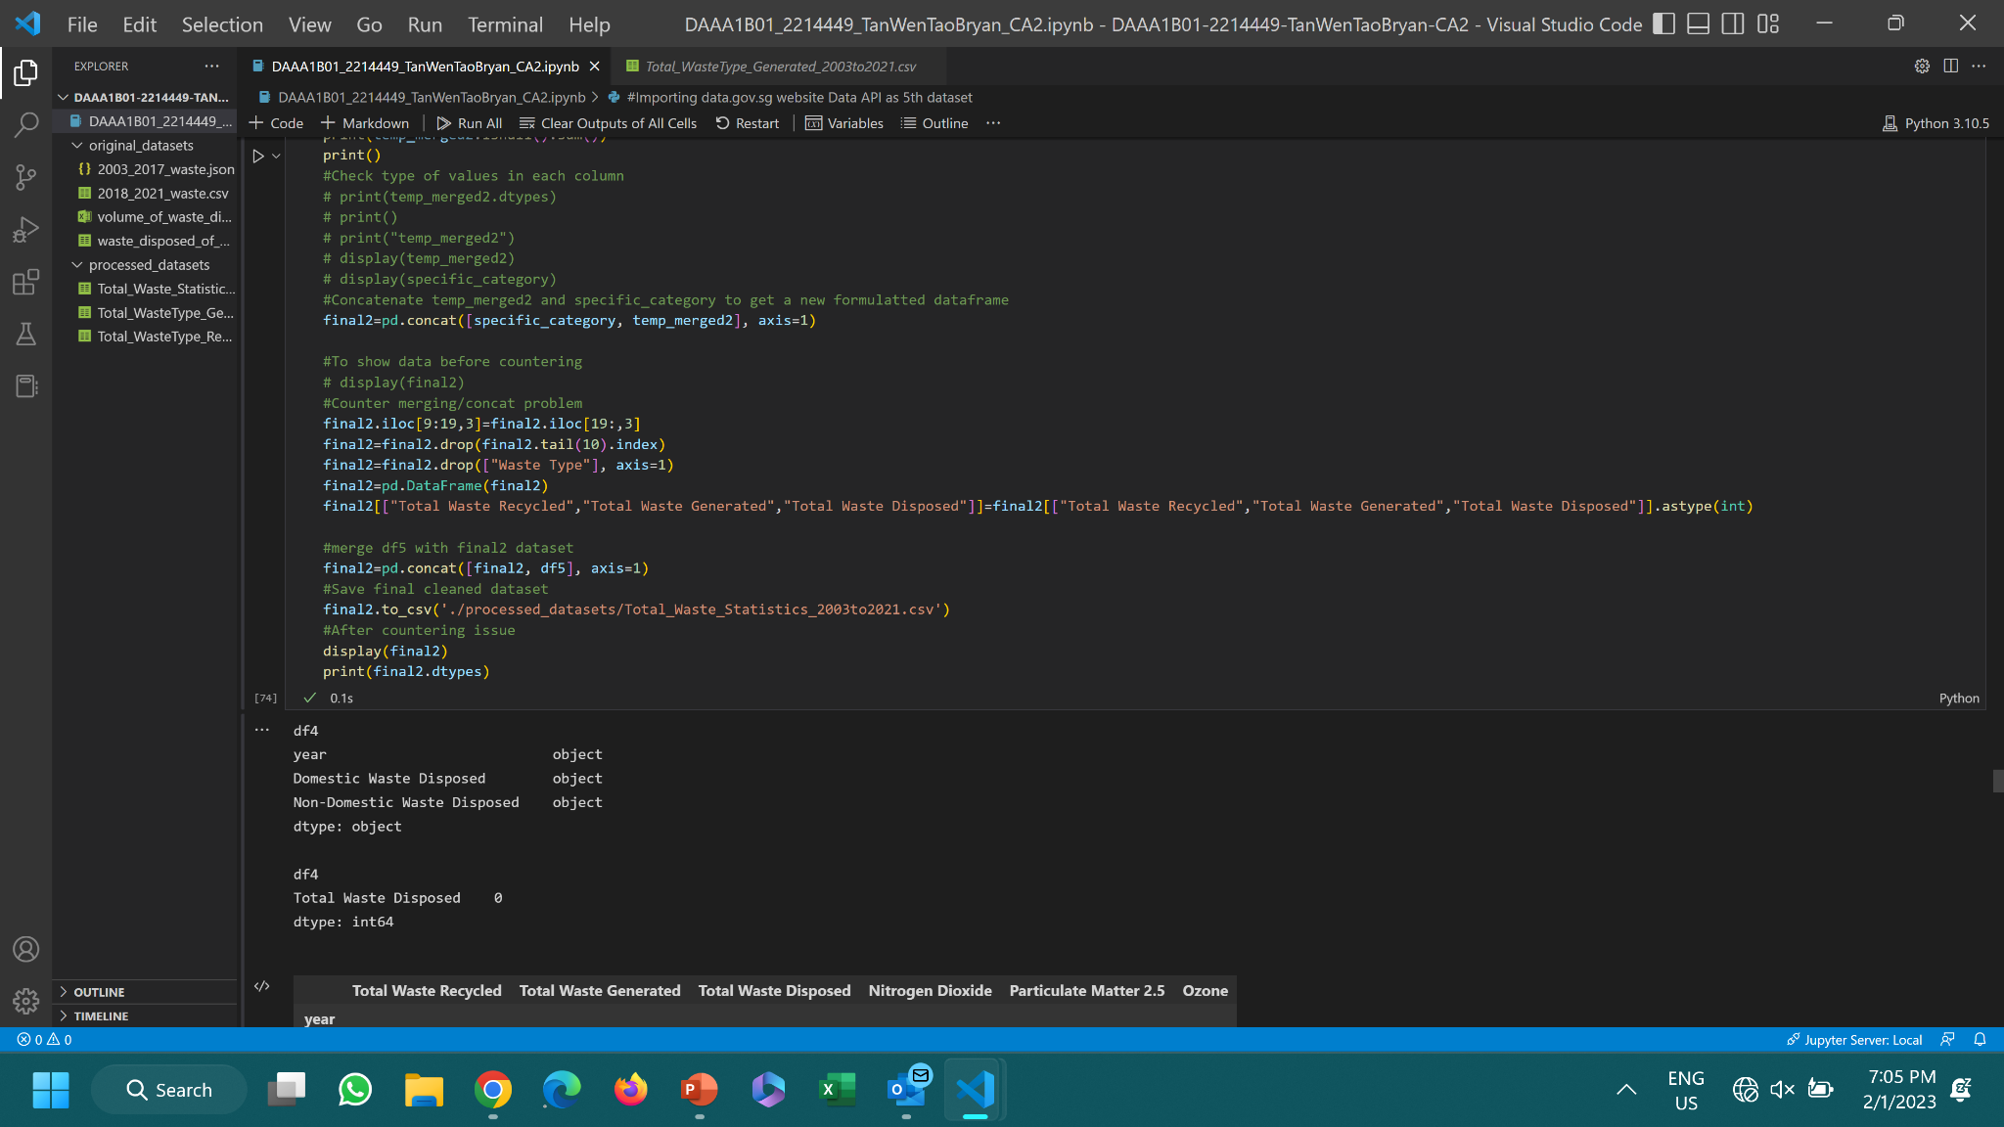
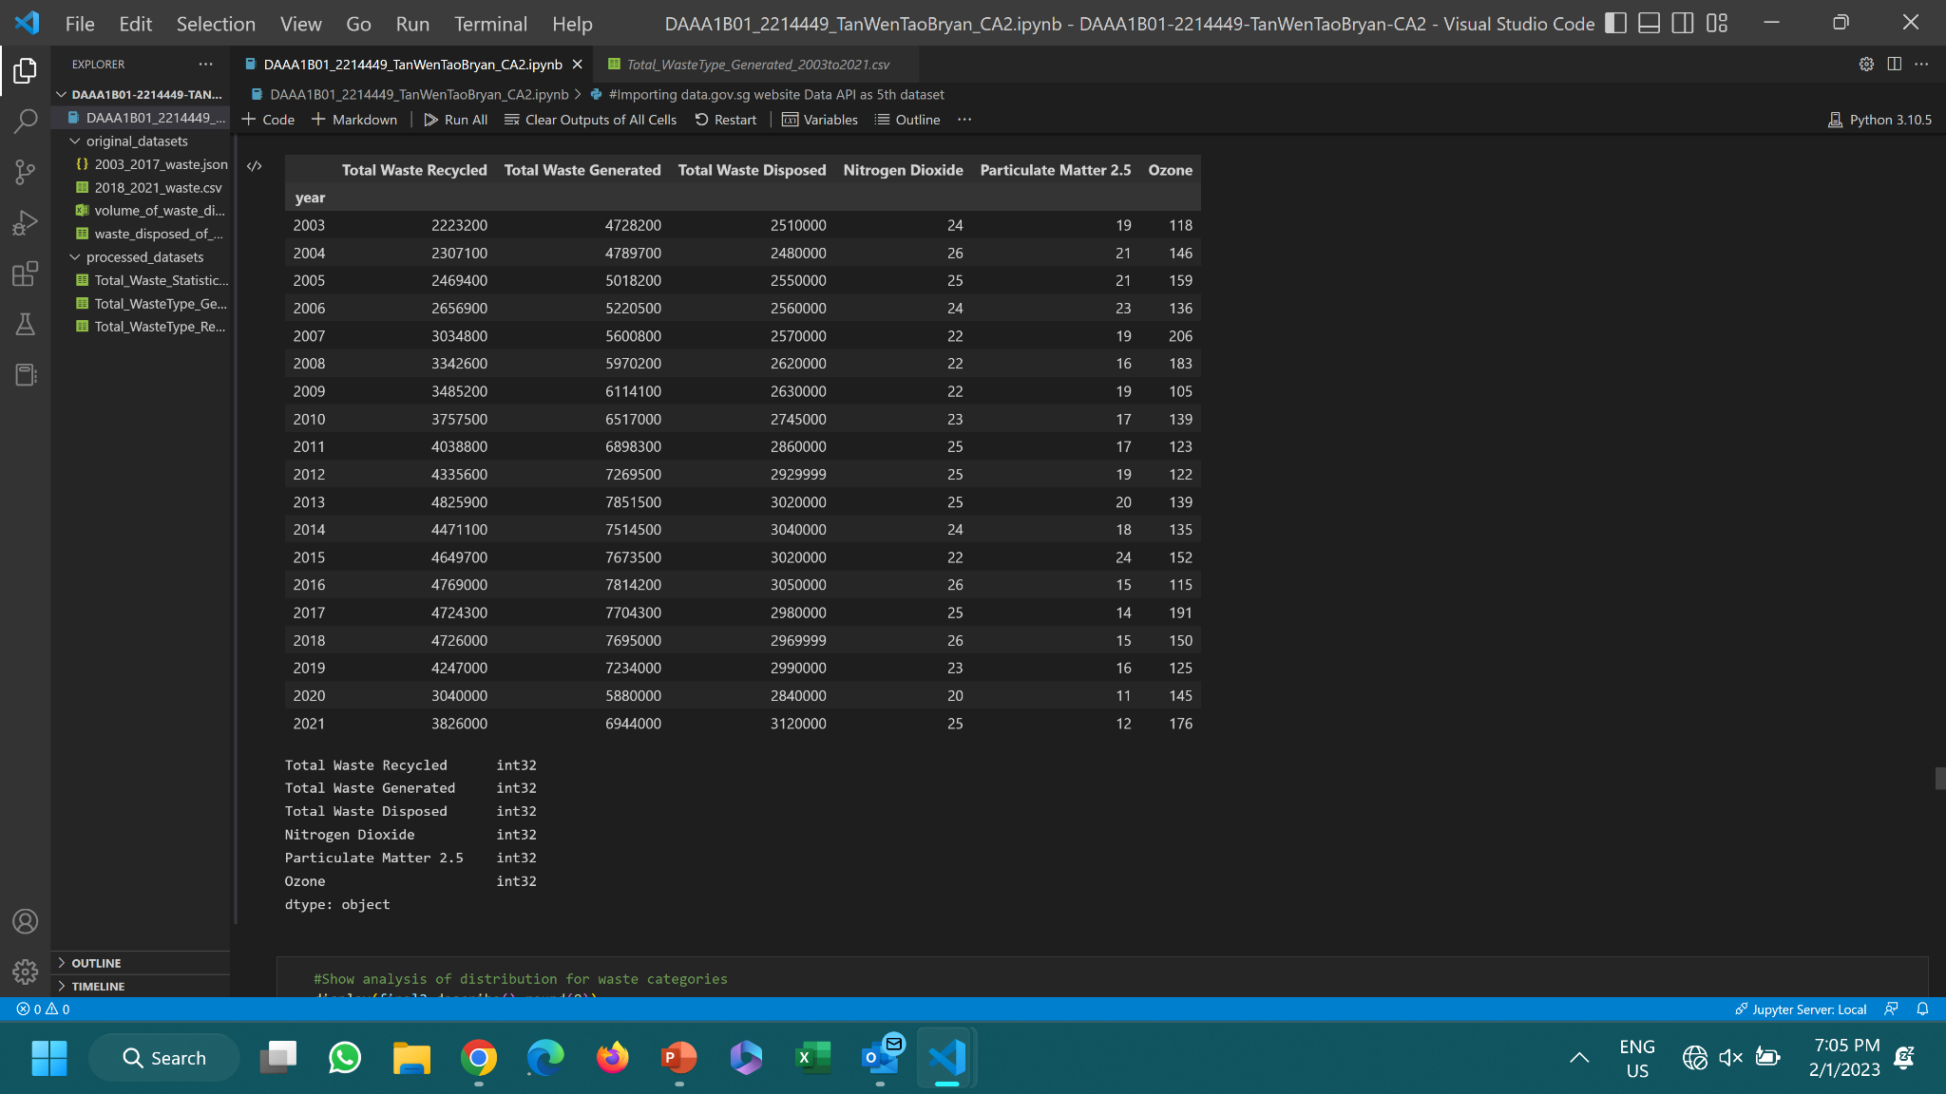
3rd Final Dataset: final2
Assign missing values of rows to be merged with the values that are supposed to be there
Drop the unnecessary rows that are not supposed to be created
Merge dataset with df5
PROBLEM IS SOLVED!!

Slide 28
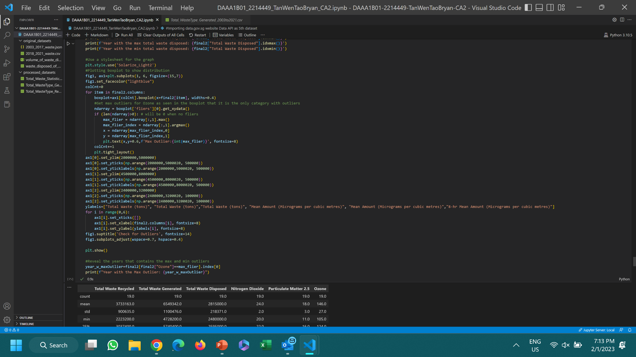
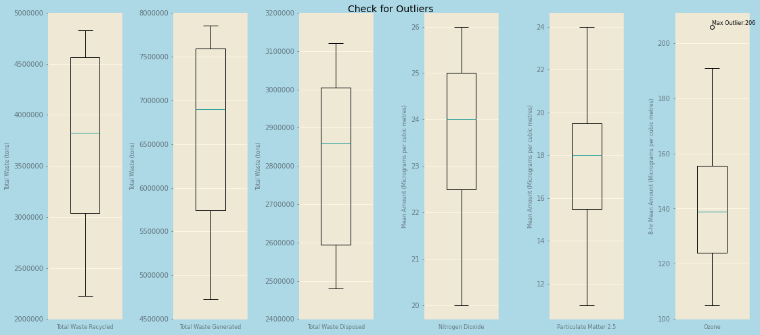
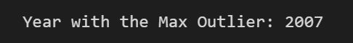
Check for outliers: final2

Slide 29
03.
Analysis
Using numerical and graphical to show insights.

Slide 30




Dataset Statistics (final1)
Waste Recycled
Glass, Others, Scrap Tyres & Textile/Leather are more consistent than the rest in being recycled. Others have least amount of waste recycled compared to the rest, while Construction Debris has the most amount of waste recycled.
Note that Ash & Sludge hasn’t got recycled for 10 years, so having a mean value that high compared to those waste type that have been recycled since 2003, this indicates that Ash & Sludge have been recovering its recyclable levels after 2013.
Waste Generated
Surprisingly, based on the mean, Paper/Cardboard have the most waste generated compared to median which shows Ferrous Metal is the one. Scrap Tyres has the least waste generated.
Glass and Scrap Tyres are more consistent that the rest in being generated. These two waste types have also low levels to be recycled and generated, which generally indicates that they have low levels of disposal too.

Slide 31

Dataset Statistics (final2)
Total Waste Generated = Total Waste Recycled + Total Waste Disposed
Waste Statistics
Overall, recyclable levels are higher than disposable levels. That means that recycling in Singapore is being taken quite seriously over the years. However, from its standard deviation, recycling is still not as consistent as waste disposal levels. Hence, there is still improvement needed.
Generally, even though 2013 has the max total waste generated, it still has the max total waste recycled. Same goes for 2003 with its min total waste generated, which really goes to show that max total waste generated does not mean max total waste being disposed. 2021 has the max total waste disposed and 2004 has the min total waste disposed.

Slide 32


Barcharts (temp_merged1)
2020
2021
Overall, in both 2020 & 2021, Ferrous Metal has the highest amount of waste recycled while Textile & Leather has the lowest amount of waste recycled. Even though 2020 has a lower number of waste being generated than 2021, it also has lower amount of waste recycled. This is probably due to COVID 19 period when policies caused economies, social activities and businesses to slow down, which are part of Singapore source of waste being generated. Hence, fewer waste is being generated, causing fewer waste to be recycled.
Certain waste types has a higher number of waste generated than waste recycled. These waste types are food, paper/cardboard and plastics as both domestic and non-domestic sectors produce high levels of these waste types but are unable to recycle them. Singapore lacks the proper infrastructure to recycle these bottles hence they will turn into general waste in the end. Moreover, consumers do not know the proper ways to recycle them, causing them to be contaminated and unable to be recycled .

Slide 33

Linechart (final2)
As seen in the line chart, trend of waste amount generated is very similar to trend of waste recycled. Both have a consistent increase from 2003-2013 and a huge decrease from 2019-2020 due to COVID 19 which diminish the waste generated produced by businesses, resulting in a lower amount of waste recycled and disposed. Waste recycled increased in 2021 but did not manage to do as well as 2019. This is due to lower construction activity and export market demands for recyclables. (NEA, 2022). Amount of waste recycled is fewer than amount of waste disposed from 2003-2005 but improved and got better than waste disposed from 2006 onwards which shows that recycling efforts have became more obvious then. Magnitude of the difference of waste disposed is not as steep compared to waste recycled, which really shows how the government is making effort to recycle as much as waste as possible.

Slide 34

Statsmodel (final2)
Code to get linear regression statistics for total waste disposed and each air pollutant

Slide 35



Statsmodel (final2)
Ozone
PM 2.5
Nitrogen Dioxide
Comparing these 3 of the 5 major air pollutants, I want to investigate which one is most affected by total waste disposed. All 3 R-squared values are not very high values as there are other factors which also contribute to emission of these air pollutants like transportation and energy production. However, the highest R-squared value belongs to PM 2.5 which indicates that 18.5% of variability in the amount of PM 2.5 can be explained by the fitted model. It might not be the best fit for the model but it is better than the other air pollutants. Since the p-value for the F-statistic is less than alpha = 0.05, this means that the amount of waste disposed is related to the amount of PM 2.5 emitted. In contrast, the other 2 models show that p-value for the F-statistic is more than alpha = 0.05 which shows that there is no relationship between total waste disposed and the other 2 air pollutants.
Looking at PM 2.5 model, the coefficient of total waste disposed is negative which shows that the two variables have a negative relationship. The p-value of the t-statistic shows that there is a 6.6% chance that the total waste disposed has no effect on the amount of PM 2.5 emitted. So, it is very unlikely that the results are being produced by chance, further proven by the fact that it is more than the alpha value of 5%.

Slide 36

Scatterplot (final2)
As the total amount of waste disposed increases, the amount of PM 2.5 decreases. A correlation coefficient value of -0.43 suggests a moderate negative relationship between these 2 variables. This is ideal which means that the amount of PM 2.5 dropped in Singapore when the total waste disposed increases, suggesting that the pollution rate of PM 2.5 is improving. However, it is not a very strong improvement which means pollution rate can be better.

Slide 37
Conclusion
Overall, Construction Debris has the most amount of waste recycled while Others has the least amount of waste recycled based on the mean values.
Overall, Paper/Cardboard has the most amount of waste generated while Scrap Tyres has the least amount of waste generated based on the mean values.
Ash & Sludge hasn’t been recycled for 10 years until 2013 started.
Glass & Scrap Tyres are more consistent in being recycled than the rest of the waste types.
In 2020 during COVID 19 period & 2021 which is post-COVID period, Ferrous Metal has the highest amount of waste recycled while Textile & Leather has the lowest amount of waste recycled.
2020 had significant lower amount of waste generated and recycled than 2021 was due to COVID 19 policies which slow down businesses and economies.
Many waste types like Food and Plastic have a way higher amount of waste generated than recycled.
Overall, waste generated and recycled have a consistent increase throughout the years, especially from 2003-2013.
Waste recycled did increase from 2020-2021 but 2021 levels were still not as high as 2019 due to lower construction activity and export market demands for recyclables as part of COVID 19 policies.
Other than the amount of waste disposed, there are clearly other factors that affect the amount of air pollutants being emitted.
Among Ozone, Nitrogen Dioxide and PM 2.5, PM 2.5 emission is most linearly related to the amount of waste disposed.
A moderate negative linear relationship is seen between amount of waste disposed and amount of PM 2.5 emissions.
This indicates that PM 2.5 emissions have been improving from the amount of waste being disposed in Singapore but pollution rate can be further improved.

Slide 38
Recommendations
In 2021, there are waste types which have a way larger amount of waste generated than recycled such as Food, Ash & Sludge, Plastic.
NEA can find some ways to reduce the waste generated or increase the amount of waste recycled:
Use components of Ash & Sludge to recreate as materials such as cement replacement in concrete or fertilisers. (Anita, 2019)
Use more food waste as composts for plants growth
Inform public through posters and advertisements to reduce food waste such as buying the appropriate portions they require
Inform public on what kind of plastic they are able to recycle like those that are not contaminated or toxic like #2 HDPE, #4 LDPE, and #5 PP. (GuideStar, 2023)
Persuade public to reduce plastic waste such as reusing plastic bags and plastic containers.
If more waste can be recycled or fewer waste can be generated, it can lead to fewer waste disposed, resulting in a decreasing pollution rate.

Slide 39
References
Anita, R., (2019). Recycling sewage sludge ash while recovering phosphorus and producing sustainable concrete [online]. Available from: https://ramboll.com/media/rgr/recycling-sewage-sludge-ash-while-recovering-phosphorus-and-producing-sustainable-concrete [Accessed at 28 Jan 2023]
GuideStar, (2023). Be Picky With Plastics [online] Available from: https://toxicfreefuture.org/healthy-choices/be-picky-with-plastics/#:~:text=When%20you%20do%20use%20plastics,cups%2C%20and%20some%20plastic%20bags. [Accessed at 28 Jan 2023]
NEA, (2022). Waste Statistics and Overall Recycling 2021 [online]. Available from: https://www.nea.gov.sg/our-services/waste-management/waste-statistics-and-overall-recycling [Accessed at 28 Jan 2023]

Slide 40
Thank You!

